Slide 1

Opioid Remediation Collaborative (ORC)
of New Mexico
orcnm.com
Heroin and Fentanyl Updates and Pharmacology

Slide 2

Disclosures
I I have no conflicts of interest to disclose.
Heroin and Fentanyl Updates and Pharmacology

Slide 3
Objectives
Describe the pharmacological properties and clinical effects of heroin.
Describe how fentanyl became the current dominant opioid supplied to the US.
Describe the multiple fentanyl formulations and their potency as well as the unique pharmacokinetic properties of fentanyl that make its treatment challenging.
Review the effects of the additive xylazine to fentanyl products and its effect.
Heroin and Fentanyl Updates and Pharmacology

Slide 4
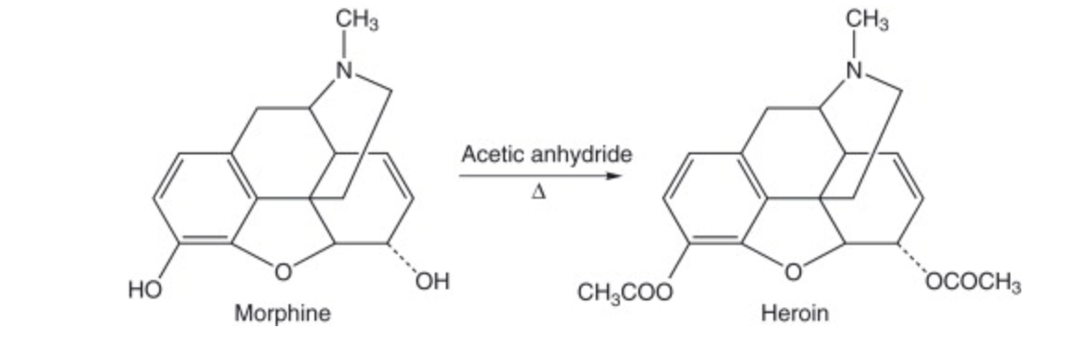
Heroin - Diacetylmorphine
Heroin is derived from the acetylation of morphine:
Heroin and Fentanyl Updates and Pharmacology

Slide 5
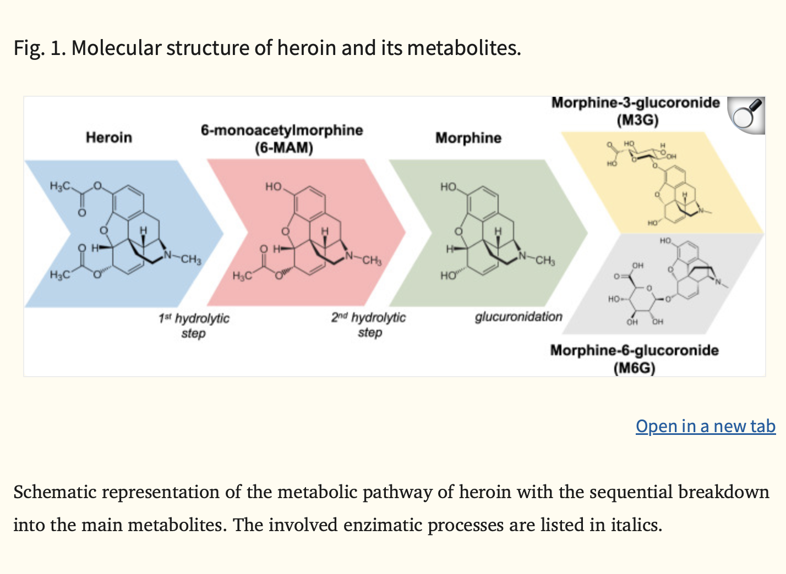
Heroin – one of the oldest most abused opioids but least studied pharmacologically
Breaks down rapidly
Milella MS, D'Ottavio G, De Pirro S, Barra M, Caprioli D, Badiani A. Heroin and its metabolites: relevance to heroin use disorder. Transl Psychiatry. 2023 Apr 8;13(1):120. doi: 10.1038/s41398-023-02406-5. PMID: 37031205; PMCID: PMC10082801.
Heroin and Fentanyl Updates and Pharmacology

Slide 6
Heroin Properties
Heroin often considered a “prodrug” – although some say this is not clear.
It is lipophilic – meaning that it can rapidly pass the blood-brain barrier.
It is very short acting lasting 3 minutes after IV injection before converted to 6-MAM which is an active metabolite.
6-MAM last only about 30 minutes in the blood and is converted to morphine.
Most IV users will describe a ”rush” lasting a minute, to a state of calm and detachment that persist for several hours.
The rapid onset and short duration of effect result in the user dosing multiple times daily.
Milella MS, D'Ottavio G, De Pirro S, Barra M, Caprioli D, Badiani A. Heroin and its metabolites: relevance to heroin use disorder. Transl Psychiatry. 2023 Apr 8;13(1):120. doi: 10.1038/s41398-023-02406-5. PMID: 37031205; PMCID: PMC10082801.
Heroin and Fentanyl Updates and Pharmacology

Slide 7
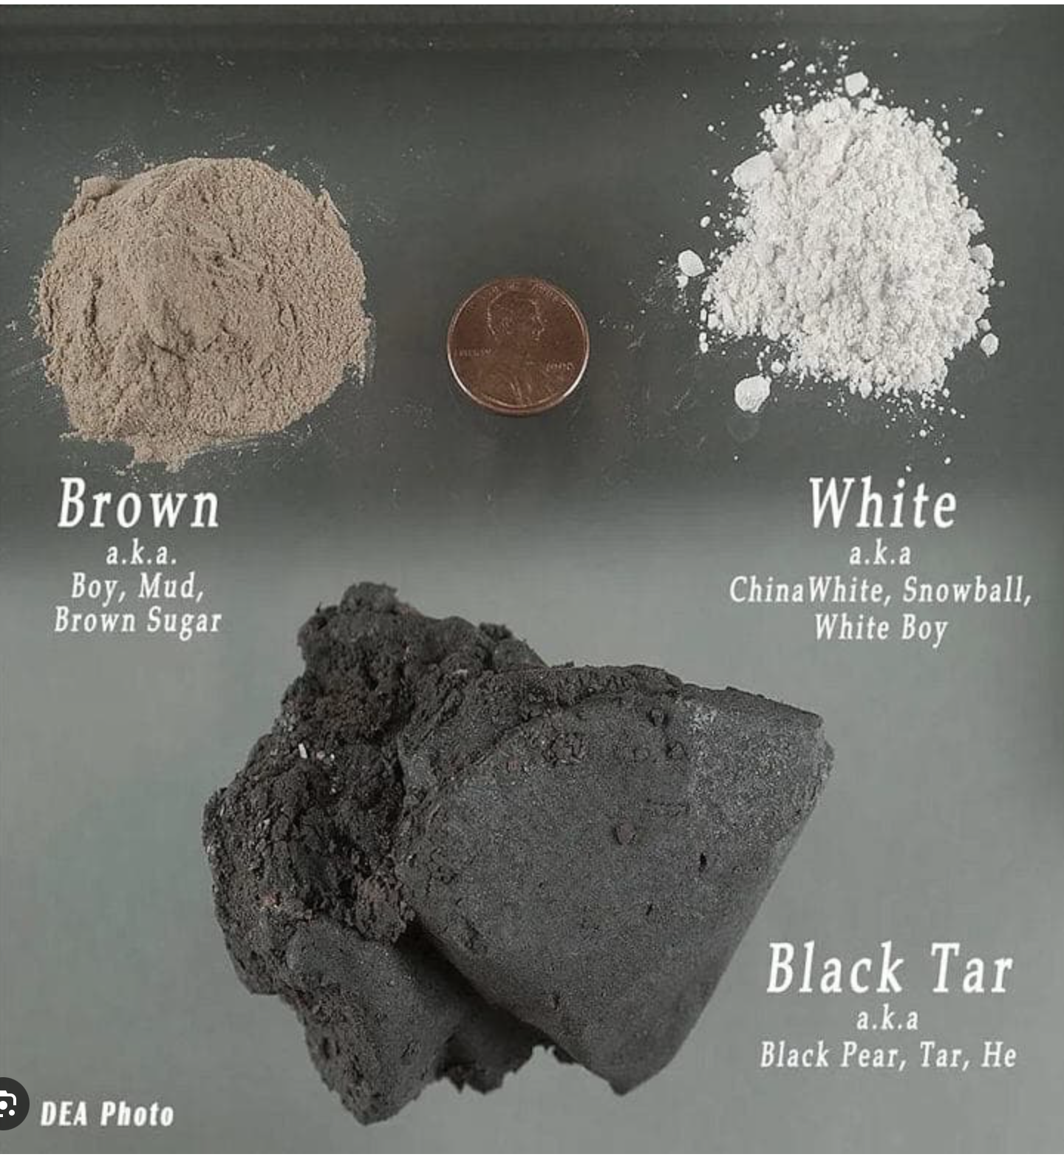
Routes of Use
Depends on the purity of heroin.
Pure heroin: White powder can be smoked or snorted.
Black Tar: sticky tar-like substance which is dissolved and injected. IV, intramuscular, SQ.
Generally not used orally – if so active ingredients broken down quickly and essentially getting low dose morphine
NIDA. 2021, April 13. What is heroin and how is it used?. Retrieved from https://nida.nih.gov/publications/research-reports/heroin/what-heroin on 2025, January 9
Heroin and Fentanyl Updates and Pharmacology

Slide 8
Clinical effects of Heroin
Acute/Short Term
Rush, followed by flushed skin
Dry mouth
Often nausea and vomiting
Itching
Drowsiness for several hours
Cognitive impairment
PR decrease; BP decrease; RR decrease
May cause pulmonary edema
Long Term
Tolerance/ Physical dependence, withdrawal after 8-12 hrs, peaking 24-48 and lasting up to 7 days
Deterioration of brain’s white matter
Medical complications from IV drug use: endocarditis, blood borne pathogens, osteomyelitis, skin abscesses, venous thrombosis, septic emboli, nephropathy, as well as those adverse effects mentioned in the prior lecture.
Heroin and Fentanyl Updates and Pharmacology

Slide 9
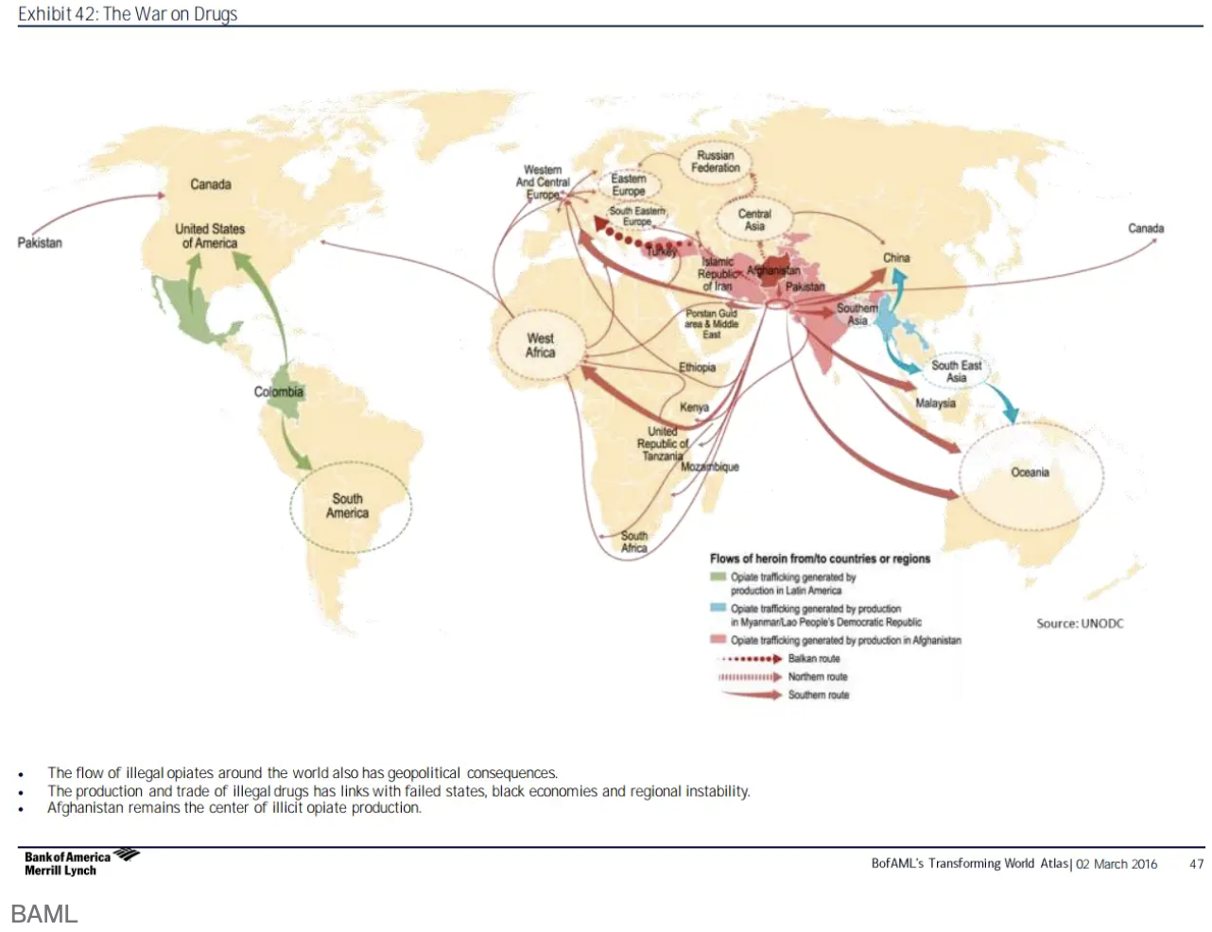
Where is Heroin made?
Heroin and Fentanyl Updates and Pharmacology

Slide 10
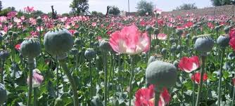
Poppy Plant Growing is Not Easy
Requires long daylight hours
Temperate Climate
Low Humidity
Proper soil acidity
Mostly grown in mountain slopes
3-5 months growth time
Processed to morphine, then heroin.
13 Kg of opium produce 1 Kg of heroin
Opium Poppy Cultivation and Heroin Processing, US Department of Justice, DEA, Sept 1992
Heroin and Fentanyl Updates and Pharmacology

Slide 11
Heroin in the early 2010s – Pre-Fentanyl
Pure heroin (white powder) predominantly from Columbia and South America and dominated the US Markets East of the Mississippi. Use was mostly snorting or smoking
Black Tar Heroin produced in Mexico and sold predominantly west of the Mississippi. Use dissolved and diluted and injected into veins, muscles or SQ.
NIDA. 2021, April 13. What is heroin and how is it used?. Retrieved from https://nida.nih.gov/publications/research-reports/heroin/what-heroin on 2025, January 9
Heroin and Fentanyl Updates and Pharmacology

Slide 12
But!!! Here’s the problem for the Cartels
Crop-based drugs are time-consuming and expensive to produce.
Traffickers lose product to weather, poor harvest and logistics to getting from the harvest to clandestine labs.
Risk of government eradication efforts.
Requires more land and labor for production.
Heroin and Fentanyl Updates and Pharmacology

Slide 13
enter…
FENTANYL

Slide 14
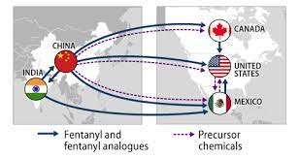
History
Fentanyl first synthesized in 1959 and used medically for pain relief
Regulated by the DEA by CSA 1970
Recent years manufacturing illicitly of fentanyl, analogs and precursors.
144 fentanyl related substances available with no legitimate use.
Once known precursors become known, producers shift to others not recognized.
Heroin and Fentanyl Updates and Pharmacology
Congressional Research Service Jan 29, 2021.

Slide 15
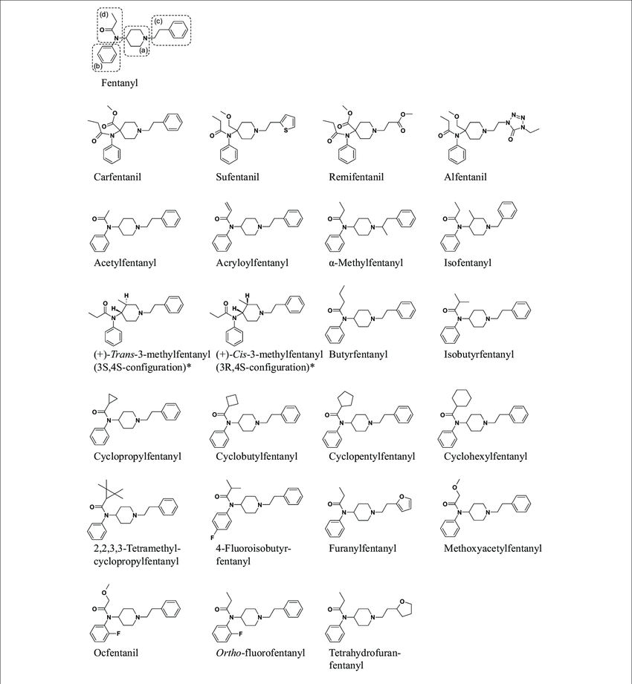
Fentanyl Analogs
Heroin and Fentanyl Updates and Pharmacology

Slide 16
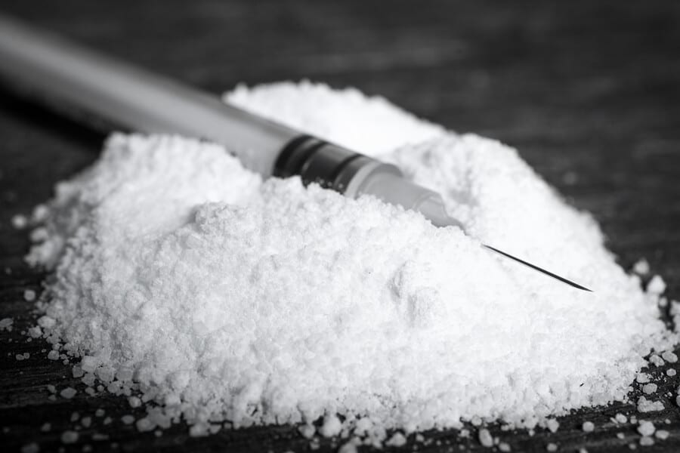
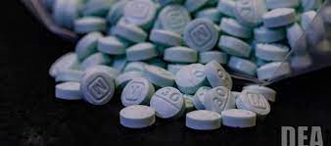
Some Illicit Fentanyl Products
Heroin and Fentanyl Updates and Pharmacology

Slide 17
Name | Potency ratio to morphine | Potency ratio to fentanyl | Legal status (US)
acetyl fentanyl | 15.7 | 0.29 | 1
alfentanil | Unknown | 0.06 | 1
alpha methyl fentanyl | 56 | 1.1 | 1
beta OH 3 methyl fentanyl | 6300 | 28 | 1
butyr-fentanyl | 7 | 0.13 | 1
furanyl fentanyl
carfentanil | 10000 | 100 | 2
fentanyl | 100 |  | 2
remifentanil |  | 10 | 2
sufentanil | 1000 | 10 | 2
Isotonitazine U-47700 | 500 7.5 | 0.1 | 1 1
Suzaki, J A review: Fentanyl and non-pharmaceutical fentanyls, Drug and Alcohol Dependence, Feb 2017, pp107-116. Last 2 items are non-fentanyl opioids – are benzimidazole and benzamide derivatives
Heroin and Fentanyl Updates and Pharmacology

Slide 18
What makes fentanyl so potent?
From our medical use, we know that fentanyl is very fast acting with a high therapeutic index.
It has similar binding affinity as morphine
But unlike morphine, fentanyl is very lipophilic. This means:
Very rapid entry to CNS across BBB
Fentanyl, when used acutely, has a short duration and a rapid exit.
But this also means over time with repeat exposure fentanyl stays in fat cells.
Villiger JW, Characteristics of [3H] fentanyl binding to the opioid receptor. Neuropharmacology 1983; 22: 447-452.Moss and Carlo Higher doses of naloxone are needed in synthetic opioid era. Substance Abuse Treatment, Prevention and Policy. (2019) 14:6.Hug et al. Tissue redistribution of fentanyl and termination of its effects in rats. Anesthesiology. 1981; 55: 369-375.
Heroin and Fentanyl Updates and Pharmacology

Slide 19
Fentanyl Metabolism
Fentanyl is metabolized by the Cytochrome P450 system primarily to Norfentanyl which has minimal to no intrinsic activity.
As yet, with the number of fentanyl analogs most of which follow the same pathway, it is still not known whether active metabolites exist.
Because of the CYP 3A4 system involvement, coadministration of inhibitors such as macrolides or protease inhibitors may prolong fentanyl activity.
Caution: Fentanyl and Norfentanyl are excreted in the urine. In chronic use there are reports of positive results > 230 days after last use.
Miranda K. Kiefer, Jamie Cowen, Katherine A. Hinely, Kara M. Rood,
Prolonged detection of urine norfentanyl in individuals enrolled in a medication for opioid use disorder in pregnancy and postpartum program: a case series, AJOG Global Reports,Volume 4, Issue 2,2024,
Heroin and Fentanyl Updates and Pharmacology

Slide 20
What does this mean?
Challenges to monitoring
Challenges to overdose management
Challenges to buprenorphine induction
Challenges to methadone treatment
We will address these challenges in future presentations!
Heroin and Fentanyl Updates and Pharmacology

Slide 21
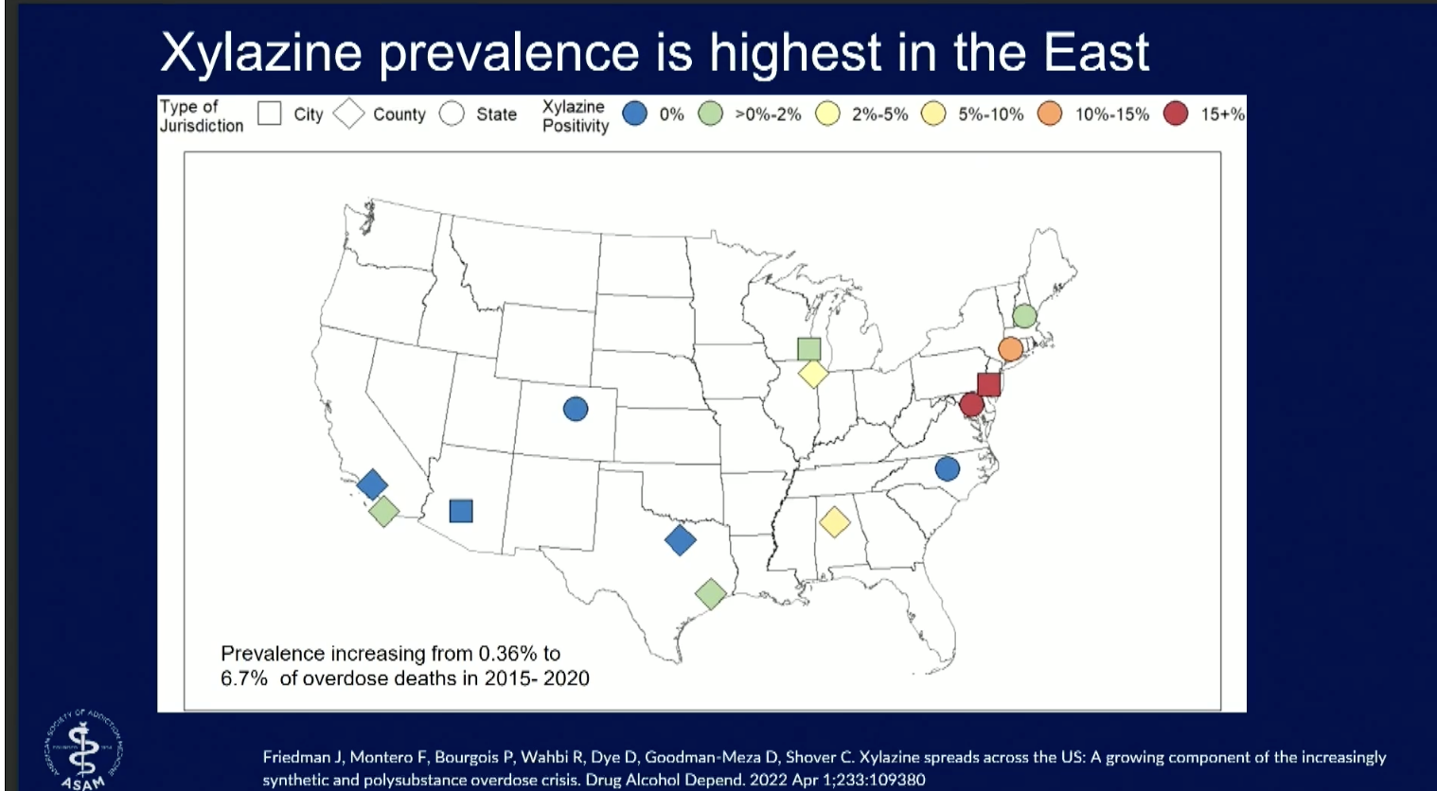
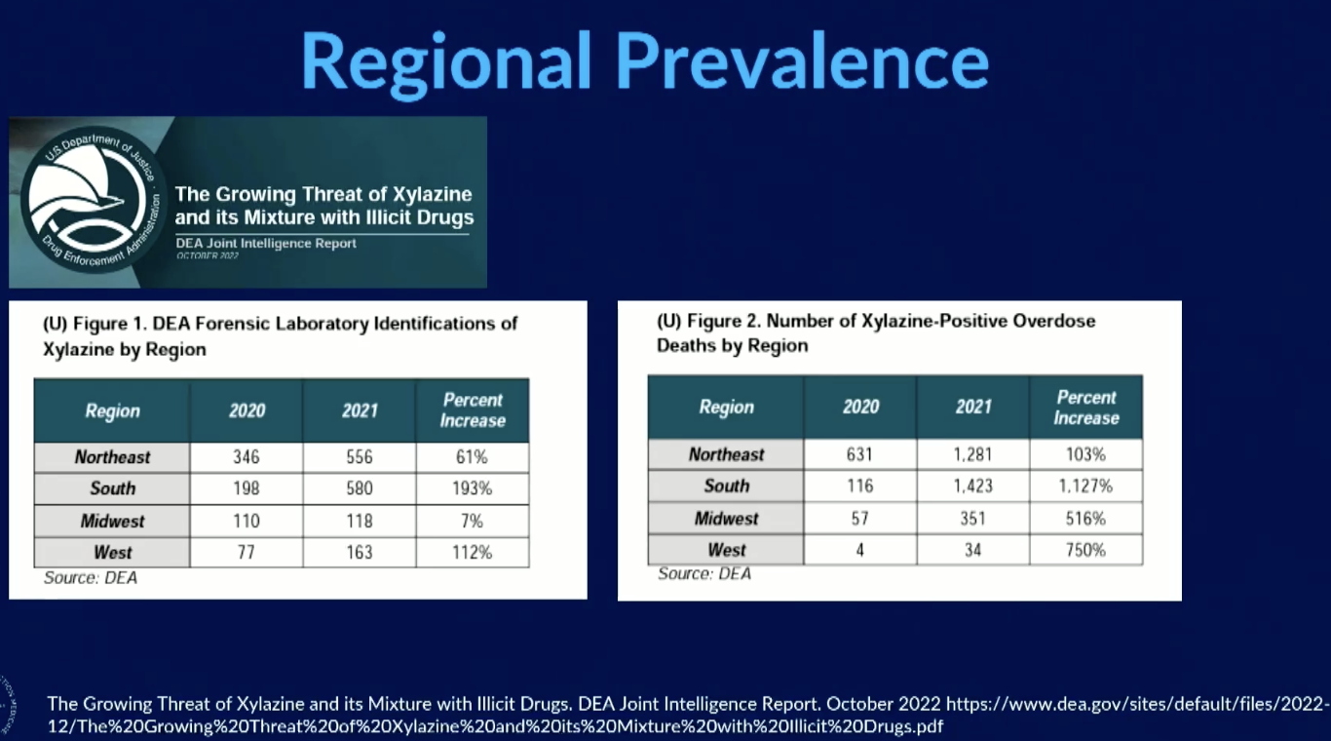
Additives – Xylazine (Tranq)
Heroin and Fentanyl Updates and Pharmacology

Slide 22
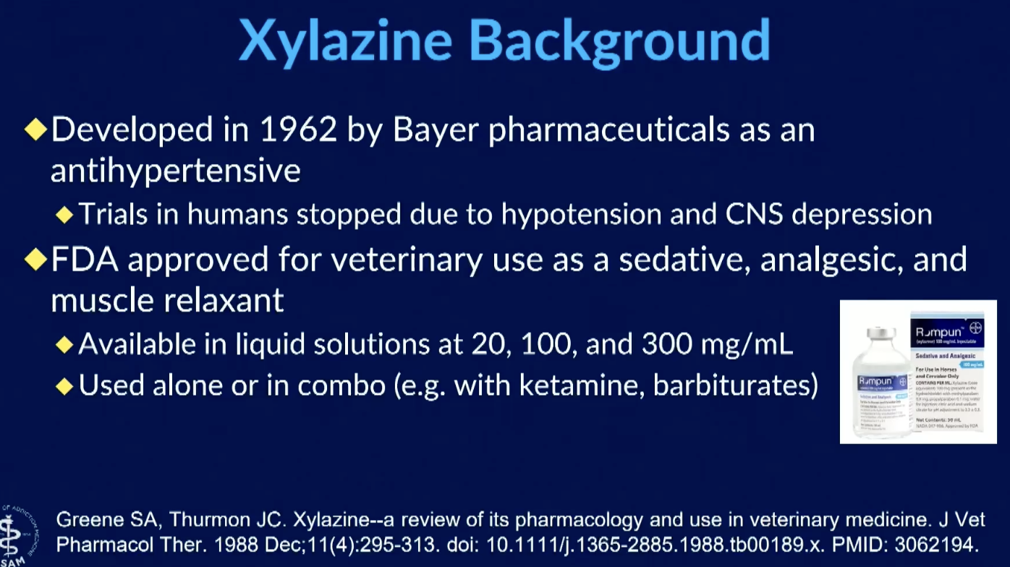
Tranq – What is it?
Heroin and Fentanyl Updates and Pharmacology

Slide 23
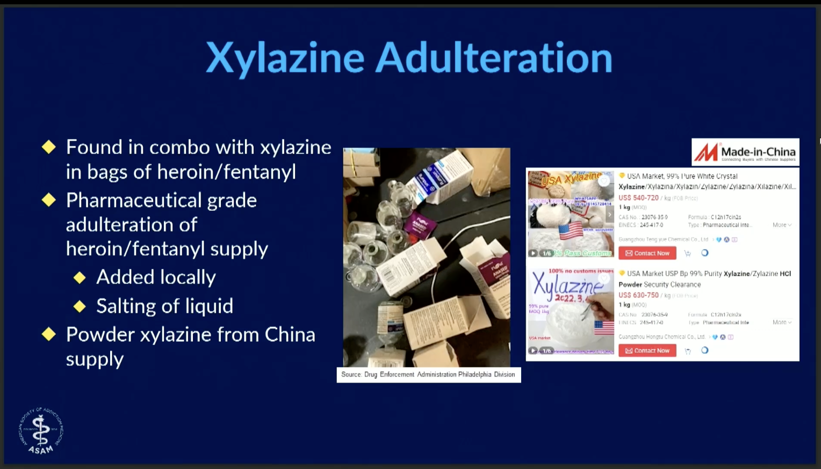
Heroin and Fentanyl Updates and Pharmacology

Slide 24
Why use Xylazine with Fentanyl?
The “high” from fentanyl lasts for a very short time compared to the effects of heroin and other opioids. Xylazine may be added, at least in part, to extend the effects of fentanyl.
Heroin and Fentanyl Updates and Pharmacology

Slide 25
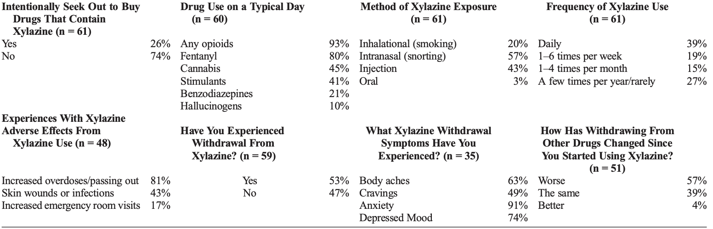
Patterns of Xylazine Use
Spadaro, Anthony MD, MPH; O'Connor, Karen MS; Lakamana, Sahithi MS; Sarker, Abeed PhD; Wightman, Rachel MD; Love, Jennifer S. MD; Perrone, Jeanmarie MD. Self-reported Xylazine Experiences: A Mixed-methods Study of Reddit Subscribers. Journal of Addiction Medicine 17(6):p 691-694, 11/12 2023.
Heroin and Fentanyl Updates and Pharmacology

Slide 26
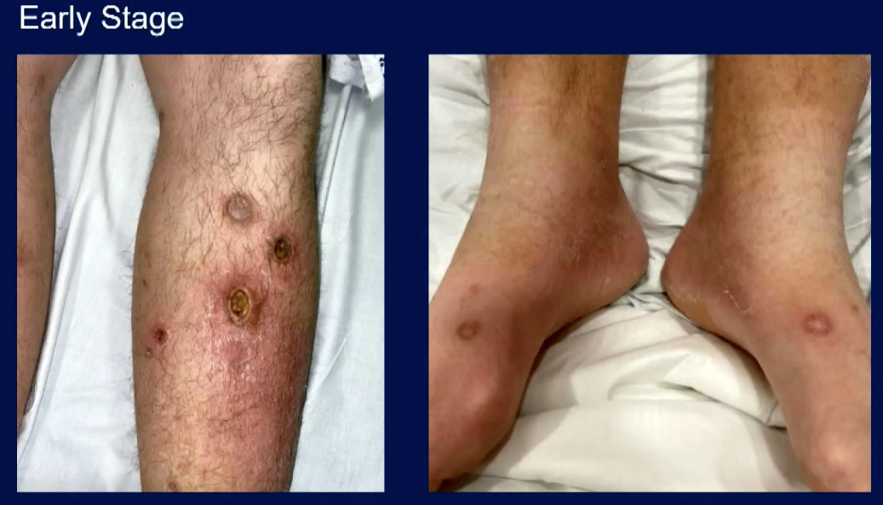
Xylazine Wounds
Heroin and Fentanyl Updates and Pharmacology

Slide 27
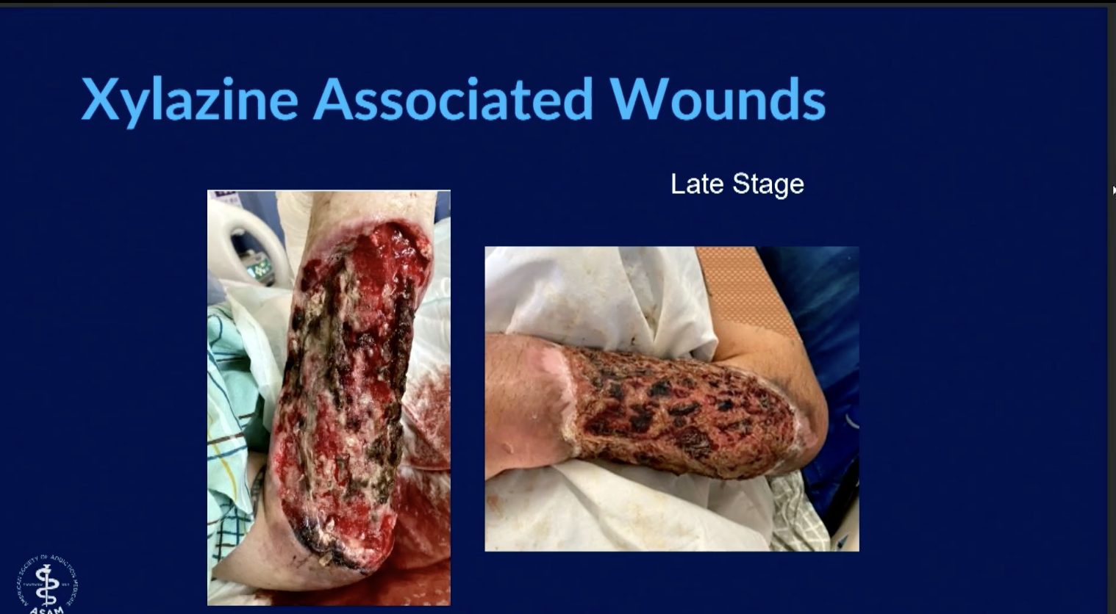
Xylazine wounds
Heroin and Fentanyl Updates and Pharmacology

