Slide 1

Opioid Remediation Collaborative (ORC)
of New Mexico
orcnm.com
Management of Alcohol Withdrawal

Slide 2

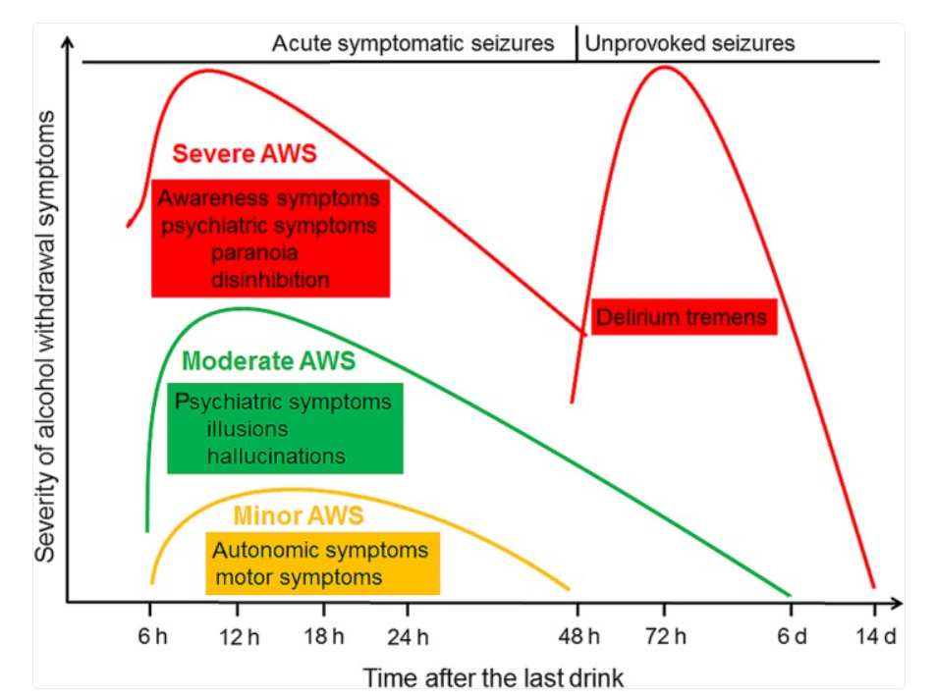
Key Clinical Features of Alcohol Withdrawal
Nausea/Vomiting
Tactile Disturbance
Auditory Disturbance
Tremor
Sweats
Visual Disturbance
Anxiety
Headache
Agitation
Orientation
https://pmc.ncbi.nlm.nih.gov/articles/PMC6084325/
Management of Alcohol Withdrawal

Slide 3
Timing of Withdrawal Symptoms
Management of Alcohol Withdrawal

Slide 4
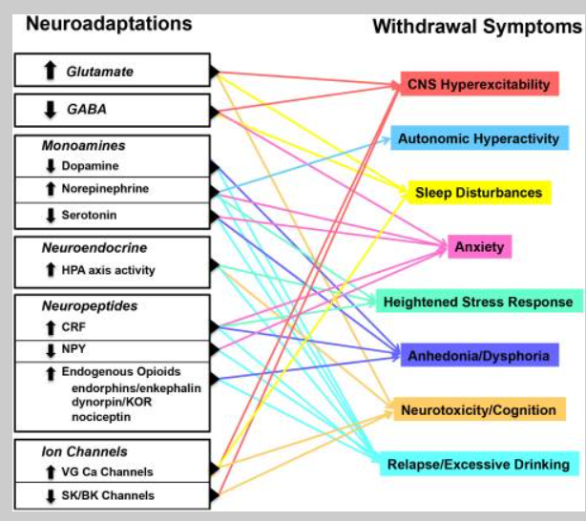
Neural mechanisms driving withdrawal
https://pmc.ncbi.nlm.nih.gov/articles/PMC6943828/
Management of Alcohol Withdrawal

Slide 5
Scoring Alcohol Withdrawal
CIWA-AR components
Nausea/Vomiting
Tactile Disturbance
Auditory Disturbance
Tremor
Sweats
Visual Disturbance
Anxiety
Headache
Agitation
Orientation
Scores:
All items on a 0-7 scale except orientation (AAO x 4).
Scores: ≤ 9 = mild w/d
10-18 moderate
> 18 severe
Management of Alcohol Withdrawal

Slide 6
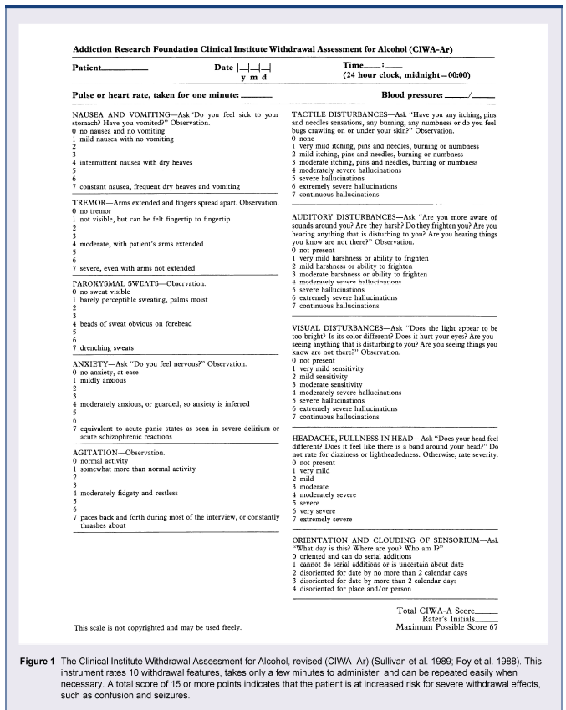
CIWA Scoring Sheet
https://pmc.ncbi.nlm.nih.gov/articles/PMC6761824/#sec2
Management of Alcohol Withdrawal

Slide 7
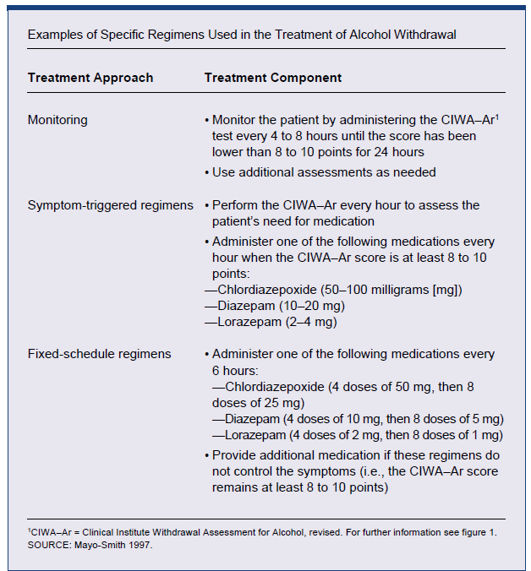
Sample Withdrawal Treatment Protocols
https://pmc.ncbi.nlm.nih.gov/articles/PMC6761824/#sec2
Management of Alcohol Withdrawal

Slide 8
Complications in Alcohol Withdrawal
Gastritis (i.e., an inflammation of the stomach lining, which often is associated with bleeding)
Gastrointestinal bleeding (e.g., from the esophagus, stomach, or intestines)
Liver disease
Acute alcoholic hepatitis (transaminitis)
Chronic fatty liver, progressing to cirrhosis
Cardiomyopathy (i.e., any disorder of the heart muscle)
Pancreatitis (i.e., an inflammation of the pancreas)
Disturbances in the electrolyte balance (e.g., alcohol ketoacidosis—a metabolic derangement that results in too much acid in the bloodstream—and abnormally low levels of magnesium in the blood)
Deficiency of the vitamin folate, which can cause lower-than-normal numbers of blood cells
Deficiency of the vitamin thiamine, which can lead to serious neurological problems, such as Wernicke’s encephalopathy (accordingly, thiamine should be administered to all patients undergoing AW to prevent the development of this syndrome).
Management of Alcohol Withdrawal
Notes:
Hallucinations: changes in perception can occur – bugs, light sensitivity, pins and needles, sensitivity to sound.
Seizures: 8-24 hours after last drink. Burst can occur over 1-6 hours. Will have EEG that is abn during period but then returns to normal. Likelihood increases after 1st sz. Also likely if recurrent withdrawals.

Slide 9
Withdrawal Seizure Management
Withdrawal seizures present a special problem in alcohol withdrawal management.
They are not the same as seizures caused by pre-existing epilepsy or seizures after traumatic brain injury(TBI). These types are best managed acutely and chronically with medications like dilantin, levetiracetem.
Alcohol withdrawal seizures in naive patients are best prevented by the existing benzodiazepine-based withdrawal protocols.
Patients with a history of prior alcohol withdrawal seizures are best protected by a combination of the existing benzodiazepine-based withdrawal protocols, with the addition of supplemental phenobarbital dosing, with strict parameters regarding dose and frequency adjustments to avoid prolonged sedation and respiratory depression.
Management of Alcohol Withdrawal

Slide 10
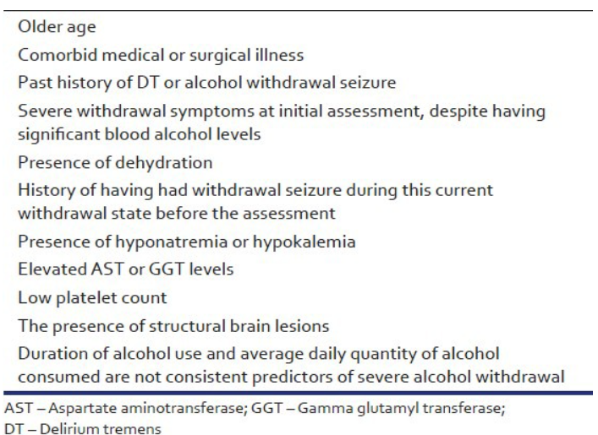
Predictors of Increased Withdrawal Seizure Risk
Management of Alcohol Withdrawal
https://pmc.ncbi.nlm.nih.gov/articles/PMC4085800/

Slide 11
Practical Management of Alcohol Withdrawal
Staff training on disease and strict adherence to protocols
Dedicated and consistent staffing is best
Uniform use of CIWA scale
CIWA is objective scoring based, not “opinion based”
Co-management of complications (gastritis, nausea, electrolytes, etc.)
Scheduled thiamine, folate and PRN antiemetics, anxiolytics, sleep aids
Avoidance of premature discontinuation of protocols (risk of delayed symptoms
Just because they are looking and feeling better does not mean they really are
Always be prepared to escalate care to a higher level of care if patient is not responding to standard protocols and interventions
Management of Alcohol Withdrawal

Slide 12
References
Alcohol Health Res World. 1998;22(1):5–12
Acta Neurol Scand. 2016 Sep 1;135(1):4–16
Handb Clin Neurol. 2014;125:133–156.
Ind Psychiatry J. 2013 Jul-Dec;22(2):100–108
Management of Alcohol Withdrawal

