Slide 1
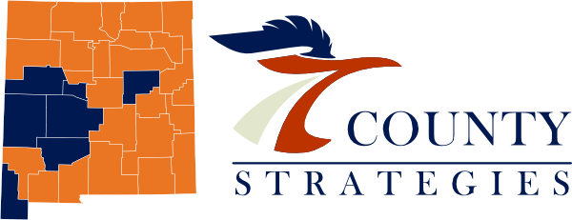
Opioid Remediation Collaborative (ORC)
of New Mexico
orcnm.com
Medical Effects of Alcohol

Slide 2

Disclosures
Consultant Medical Director:
Turning Point Recovery Center, Albuquerque
Vista Taos, Taos
LifeHouse, Carlsbad
Consultant Clinical Director:
Southwest Laboratories, Albuquerque
Addiction Medicine Team Consultant:
Opioid Remediation Collaborative of New Mexico
(ORCNM.com)
Medical Effects of Alcohol

Slide 3
What is the interaction of Opiate Use Disorder with Alcohol Use Disorder?
Few studies have examined co-use of alcohol and opioids, but available data suggest that co-use is common and likely contributes to opioid overdose-related morbidity and mortality.
Co-use of opioids and alcohol is related to worse outcomes in treatment for either substance.
Among 3.1 million patients surveyed with OUD and related conditions:
AUD is diagnosed 8.4 times more frequently than in patients without OUD.
Binge drinking is 5.0 times more common in patients with OUD.
Medical Effects of Alcohol

Slide 4
What is the interaction of Opiate Use Disorder with Alcohol Use Disorder?
According to the report on alcohol and drug use from the Michigan Department of Health and Human Services, among youths in 2011:
28.0% of binge drinkers reported using painkillers (including oxycontin, codeine, and Percocet).
only 7.0% of nondrinkers and 15.6% of non-binge drinkers took opioids.
Witkiewitz K, Vowles KE. Alcohol and Opioid Use, Co-Use, and Chronic Pain in the Context of the Opioid Epidemic: A Critical Review. Alcohol Clin Exp Res. 2018 Mar;42(3):478-488. doi: 10.1111/acer.13594. Epub 2018 Feb 6. PMID: 29314075; PMCID: PMC5832605.
Medical Effects of Alcohol

Slide 5
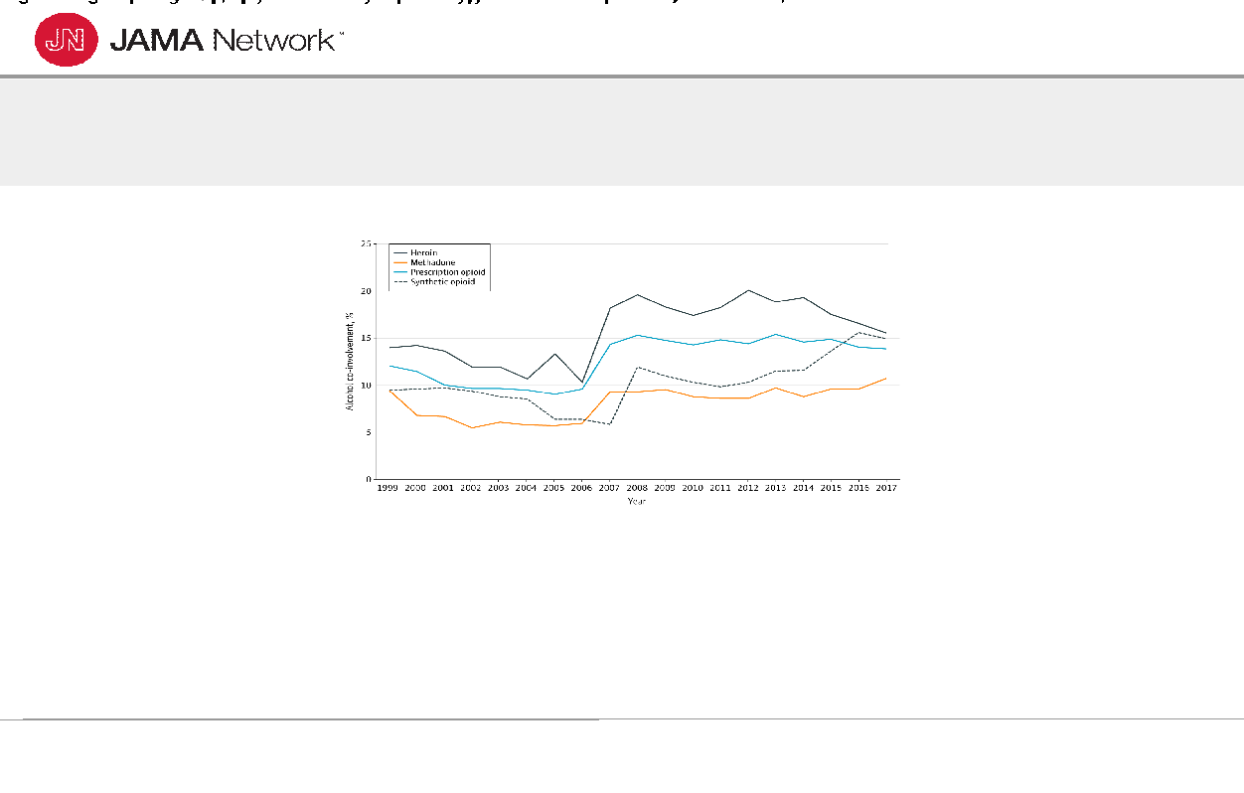
Medical Effects of Alcohol

Slide 6
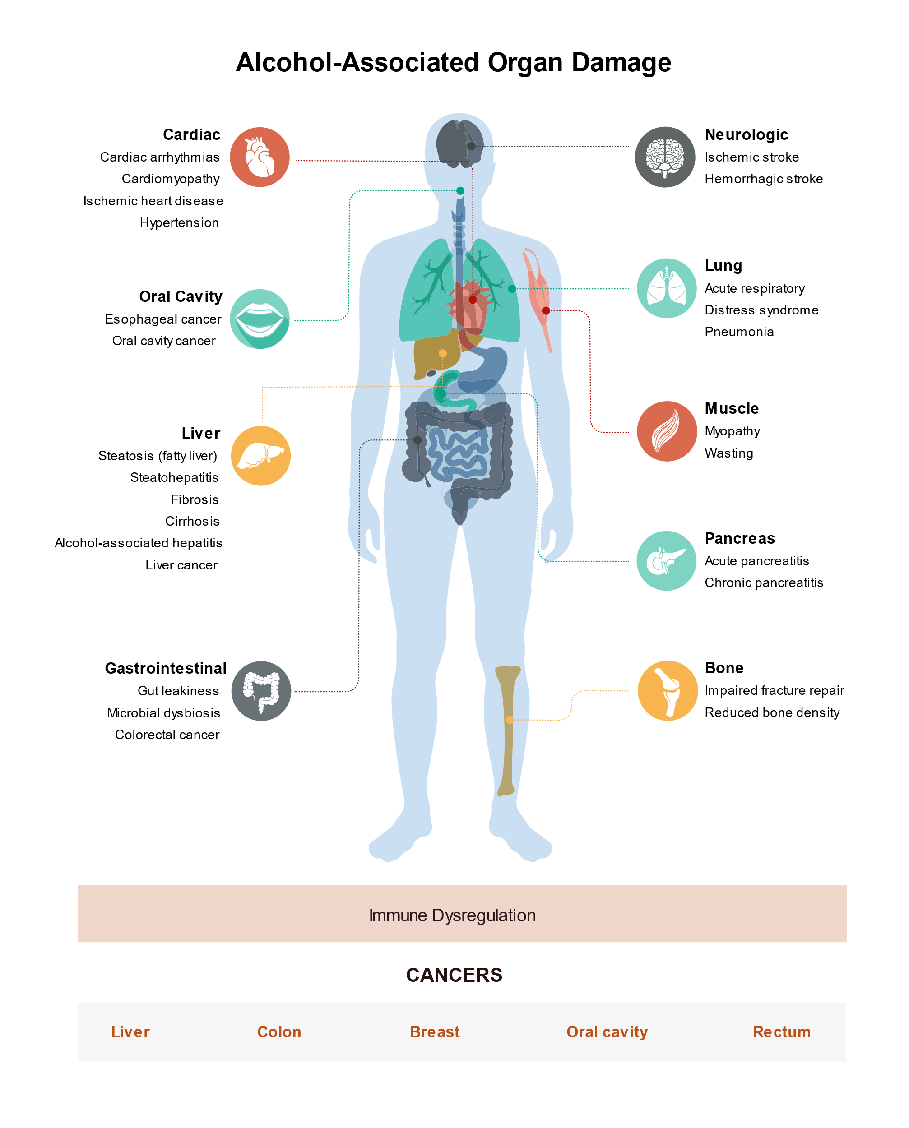
Medical Effects of Alcohol on Overall Health
https://www.niaaa.nih.gov/alcohols-effects-health/alcohols-effects-body
Medical Effects of Alcohol

Slide 7
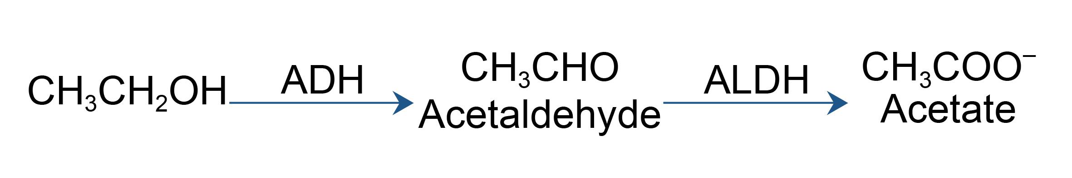
The Metabolism of Alcohol
https://www.niaaa.nih.gov/publications/alcohol-metabolism
Medical Effects of Alcohol

Slide 8
Effects on the Pancreas
Alcohol causes the pancreas to produce toxic substances that can eventually lead to pancreatitis, a dangerous inflammation in the pancreas that causes its swelling and pain (which may spread) and impairs its ability to make enzymes and hormones for proper digestion.
Acute and Chronic pancreatitis
Painful
Can produce septic abdominal abscesses and pseudocysts
Not correlated to amount or chronicity of alcohol ingested
Types I and Type II diabetes
Type II – Metabolic Syndrome, may require insulin if oral medications fail
Type I – destruction of insulin-producing cells, lifetime dependency on insulin
Medical Effects of Alcohol

Slide 9
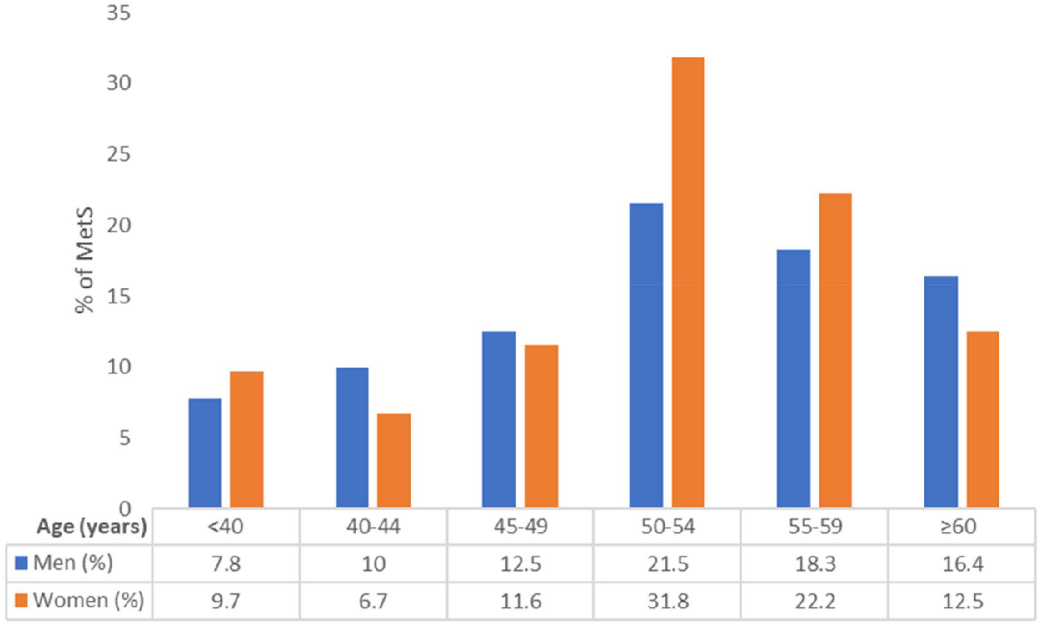
Effects of Alcohol Use Disorder on Metabolic Syndrome
https://www.nature.com/articles/s41598-022-06010-3
Medical Effects of Alcohol

Slide 10
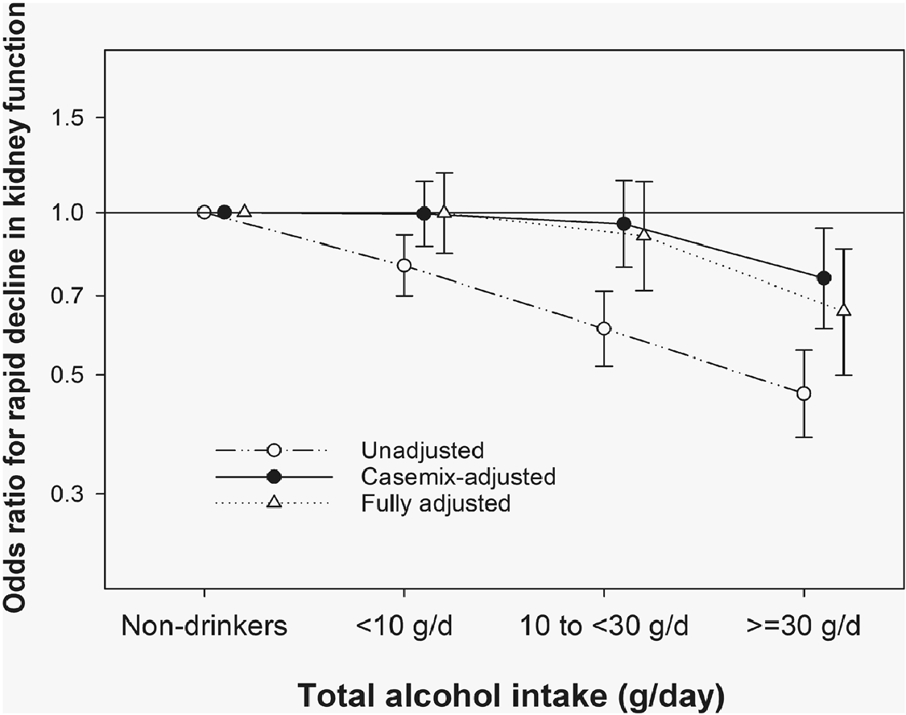
Effects on
Kidney Function
https://www.nature.com/articles/s41598-022-06010-3
Medical Effects of Alcohol

Slide 11
Effects on the Brain & Nervous System
Alcohol interferes with the brain’s communication pathways, and can affect the way the brain looks and works.
These disruptions can acutely and chronically change mood and behavior, and make it harder to think clearly and move with coordination.
Alcohol, combined with nutritional deficiencies (B vitamins), leads to:
Wernicke-Korsakoff dementias
Peripheral neuropathies affecting sensation and balance
Skeletal muscle damage, with resulting overall weakness
Medical Effects of Alcohol

Slide 12
Effects on the Heart & Circulation
Drinking a lot over a long time or too much on a single occasion can damage the heart, causing problems including:
Cardiomyopathy – Stretching and drooping of heart muscle
Arrhythmias – Irregular heart beat
Stroke
Directly through high blood pressure and arrhythmias
Indirectly through alcohol-mediated damage to the structure of blood vessels
High blood pressure
The single most powerful modifiable risk factor for hypertension
Medical Effects of Alcohol

Slide 13
Effects on the Liver
Heavy drinking takes a toll on the liver, and can lead to a variety of problems and liver inflammations including:
Steatosis, or fatty liver
Alcoholic hepatitis
When combined with Hepatitis B or Hepatitis C from IV drug use, can be lethal
Fibrosis
Cirrhosis
Cancers
Medical Effects of Alcohol

Slide 14
Effects on the Immune System
Drinking too much can weaken your immune system, making your body a much easier target for disease.
Chronic drinkers are more liable to contract diseases like pneumonia and tuberculosis than people who do not drink too much.
Drinking a lot on a single occasion slows your body’s ability to ward off infections – even up to 24 hours after getting drunk.
Concomitant use of opiates increases risk of contracting HIV, Hepatitis C and Hepatitis B due to impaired behavioral choices and reduced immunity due to alcohol
Medical Effects of Alcohol

Slide 15
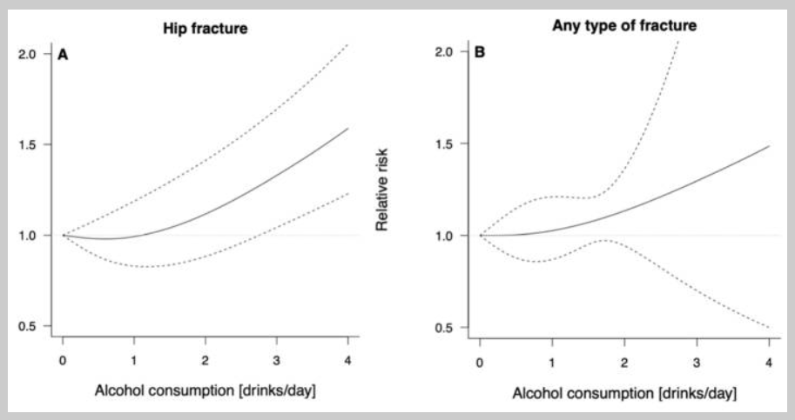
Effects of Alcohol on Risk of Skeletal Injury
https://pmc.ncbi.nlm.nih.gov/articles/PMC8835521/
Medical Effects of Alcohol

Slide 16
Alcohol & Cancer
Clear patterns have emerged between alcohol consumption and increased risks of certain types of cancer:
Head and neck cancer, including oral cavity, pharynx, and larynx cancers.
Esophageal cancer, particularly esophageal squamous cell carcinoma. In addition, people who inherit a deficiency in an enzyme that metabolizes alcohol have been found to have substantially increased risks of esophageal squamous cell carcinoma if they consume alcohol.
Medical Effects of Alcohol

Slide 17
Alcohol & Cancer
Liver cancer.
Breast cancer: Research has shown an important association between alcohol consumption and breast cancer—even one drink per day can increase a woman's risk for breast cancer by 5% to 15% compared to women who do not drink at all.
Colorectal cancer.
Medical Effects of Alcohol

Slide 18
Cancer risks with alcohol
Head and Neck Cancers:
Moderate drinkers (< 2 drinks/day for men, < 1 drinks/day for women):
1.8x higher risk of oral cavity and pharynx cancers
1.4x higher risk of laryngeal cancers
Heavy drinkers ( 15+ drinks/week for men, 8+ drinks/week for women)
5.0x higher risk of oral cavity and pharynx cancers
2.6x higher risk of laryngeal cancers
Drinking and smoking
The combination raises the risks exponentially
Medical Effects of Alcohol

Slide 19
Cancer risks with alcohol (cont’d)
Liver Cancer:
Heavy drinkers
2.0x higher risk of hepatocellular cancer and cholangiocarcinoma
Even higher with OUD due to alcohol plus hepatitis C and HIV
https://www.cancer.gov/about-cancer/causes-prevention/risk/alcohol/alcohol-fact-sheet
Medical Effects of Alcohol

Slide 20
Cancer risks with alcohol (cont’d)
Breast Cancer:
Pooled data from 118 individual studies indicates that light drinkers have a slightly increased (1.04-fold higher) risk of breast cancer, compared with non drinkers.
The risk increase is greater in moderate drinkers (1.23-fold higher) and heavy drinkers (1.6-fold higher) .
An analysis of prospective data for 88,000 women participating in two US cohort studies concluded that for women who have never smoked, light to moderate drinking was associated with a 1.13-fold increased risk of alcohol-related cancers (mostly breast cancer)
Medical Effects of Alcohol

Slide 21
Cancer risks with alcohol (cont’d)
Colorectal Cancer:
Moderate to heavy alcohol consumption is associated with 1.2- to 1.5-fold increased risks of cancers of the colon and rectum compared with no alcohol consumption
https://www.cancer.gov/about-cancer/causes-prevention/risk/alcohol/alcohol-fact-sheet
Medical Effects of Alcohol

Slide 22
Is any alcohol intake safe?
Based on increasing amounts of evidence, probably………………..not!
Susceptibility to the toxic effects of alcohol is highly variable, based on:
gender
age
genetics
family
racial
Social/cultural norms
Mixing alcohol with opiates in any quantity is a recipe for disaster
AUD + OUD is a disaster
Medical Effects of Alcohol

Slide 23
References
ttps://www.niaaa.nih.gov/alcohols-effects-health/alcohols-effects-body
https://www.cancer.gov/about-cancer/causes-prevention/risk/alcohol/alcohol-fact-sheet
https://www.niaaa.nih.gov/publications/alcohol-metabolism
https://www.nature.com/articles/s41598-022-06010-3
https://www.nature.com/articles/ s41598-021-81777-5
https://pmc.ncbi.nlm.nih.gov/articles/PMC8835521/
Witkiewitz K, Vowles KE. Alcohol and Opioid Use, Co-Use, and Chronic Pain in the Context of the Opioid Epidemic: A Critical Review. Alcohol Clin Exp Res. 2018 Mar;42(3):478-488. doi: 10.1111/acer.13594. Epub 2018 Feb 6. PMID: 29314075; PMCID: PMC5832605.
Medical Effects of Alcohol

