Slide 1
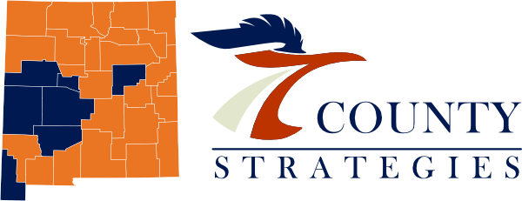
Opioid Remediation Collaborative (ORC)
of New Mexico
Opioid Use Disorders
History and Epidemiology

Slide 2

Disclosures
I I have no conflicts of interest to disclose.
Opioid Use Disorder History and Epidemiology

Slide 3
Objectives
To provide a summary of past opioid problems and its correlates to the current crisis.
To describe the factors influencing the subsequent waves of opioid overdose deaths.
To provide updates in recent overdose trends.
Describe some of the challenges of the current opioid crisis.
Opioid Use Disorder History and Epidemiology

Slide 4
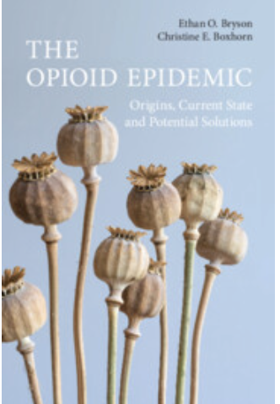
The First Opioid Epidemic
From 4000 BC, opium from poppy plants was used medically and recreationally.
1803 Morphine was first isolated from opium in Germany.
With development of hypodermic needle – morphine use intensified as it was used on soldiers in the Civil War.
Schmitt, K, “A Brief History of Opioids in the US,” Hopkins Bloomberg Public Health Magazine, Nov 8, 2023, access magazine. Publichealth.jhu.edu
Opioid Use Disorder History and Epidemiology

Slide 5
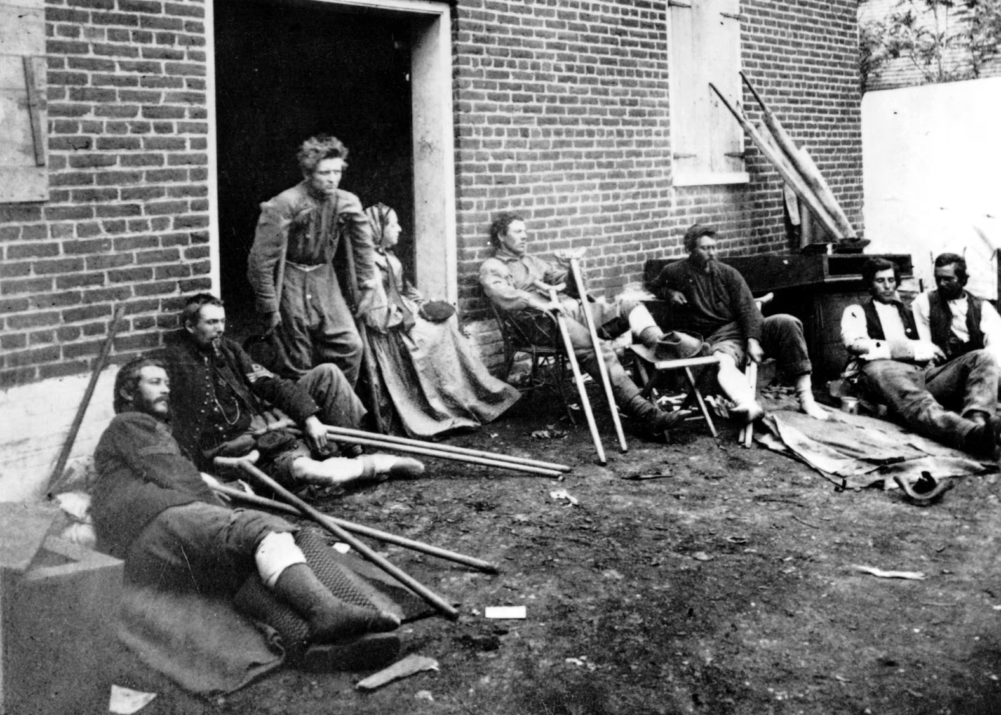
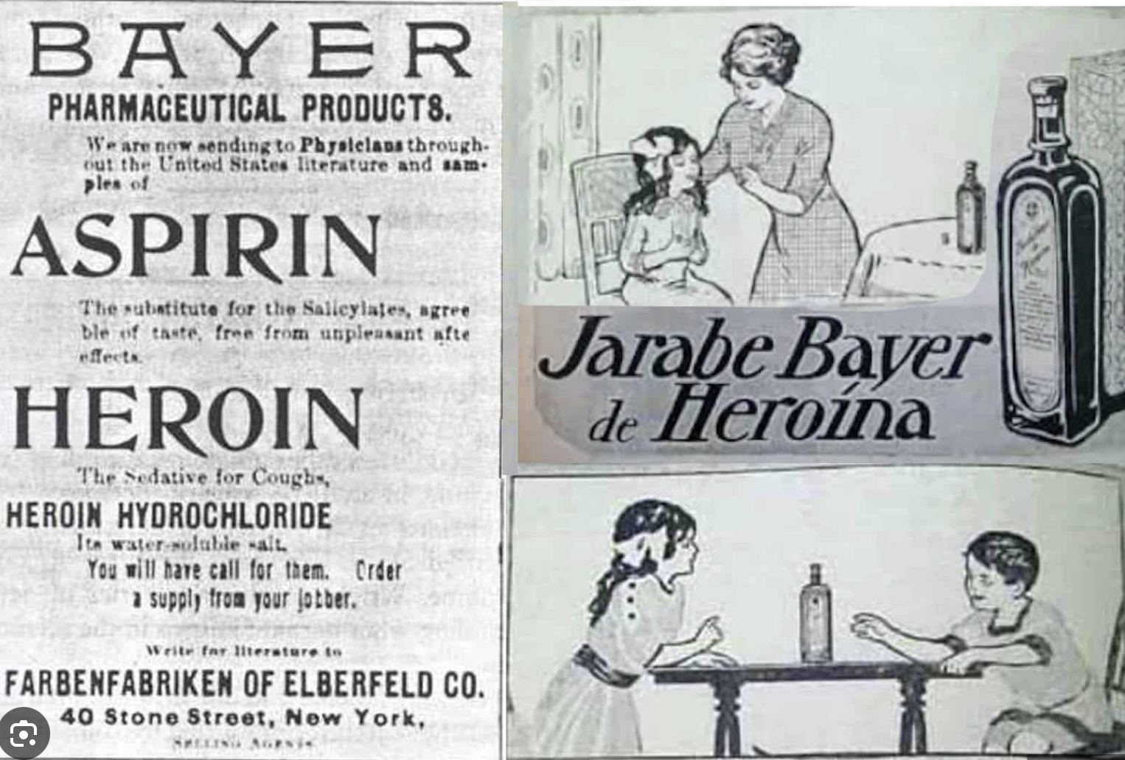
The First Opioid Epidemic
With the rise in morphine addiction following the Civil War (> 400K soldiers), Bayer pharmaceuticals synthesized heroin in 1874 attempting to create a less addictive opioid and marketed as a cough medicine.
Heroin became a bigger problem than MS.
Bryson EO, Boxhorn CE. A Brief History of Opioid Misuse and Addiction. In: The Opioid Epidemic: Origins, Current State and Potential Solutions. Cambridge University Press; 2023:3-11
Opioid Use Disorder History and Epidemiology

Slide 6
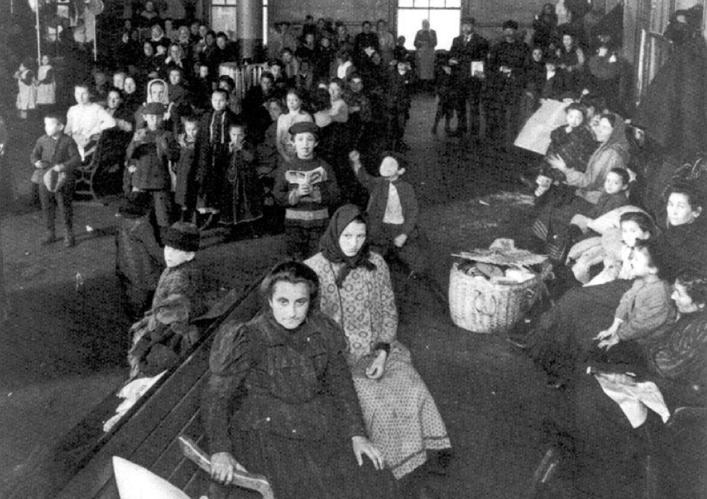
The American War on Drugs Begins
By 1908 many Americans began to be affected by drug problems.
Roosevelt established a commission proposing a gradual abolition of the trade of heroin and control opioid use.
The Harrison Act (1914): imposed taxes and restricted sale of opium and coca leaves.
Anti-Heroin Act 1924: illegal to make, import or sell heroin
Bryson EO, Boxhorn CE. A Brief History of Opioid Misuse and Addiction. In: The Opioid Epidemic: Origins, Current State and Potential Solutions. Cambridge University Press; 2023:3-11
Opioid Use Disorder History and Epidemiology

Slide 7
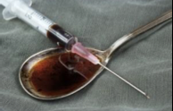
Post-Harrison Act
Most Opioid Use Disorders in the 1950s through 1970s were due to illicit heroin and African Americans and males affected disproportionately.
While the Harrison Act itself didn’t prohibit prescribing of opioids, the federal agencies interpreted using opioids in patients with addiction was a crime -> 25,000 physicians arrested and 10% imprisoned .
Limited prescription of opioids including to cancer patient with pain.
Kleber HD. Methadone Maintenance 4 Decades Later. JAMA. 2008;300(19):2303–2305. doi:10.1001/jama.2008.648
Opioid Use Disorder History and Epidemiology

Slide 8
The 70s
War on Drugs:
  returning soldiers from Vietnam were using heroin
  urban crime was increasing related to heroin use
Controlled Substance Act of 1970 – established the DEA and scheduling of potentially addictive drugs.
1974: methadone maintenance programs began
Kleber HD. Methadone Maintenance 4 Decades Later. JAMA. 2008;300(19):2303–2305. doi:10.1001/jama.2008.648
Opioid Use Disorder History and Epidemiology

Slide 9
The 80s and 90s –The Rise and Recognition of the Undertreatment of Pain
116 million people in the US suffer with pain – which is more than diabetes, cancer and heart disease combined¹
1 in 5 adults have chronic pain²
1 in 14 adults have “high impact” pain²
Annual health care costs – expenses, lost wages, productivity loss estimated to be $635 billion¹
Opioid Use Disorder History and Epidemiology
Notes:
High impact pain severely interferes with daily function.

Slide 10
The Promotion of the use of Opioid Analgesia
Multiple publications describing poorly treated pain and small sample sized studies showing the use of opioids for nonmalignant pain did not lead to abuse.
WHO addressed under-treatment of pain in 1986 publication.
American Pain Society launched ”Pain as the 5th Vital Sign.”
Joint Commission published standards for pain management with need to quantify pain during encounters.
Jones, M et al, “A Brief History of the Opioid Epidemic and Strategies for Pain Medicine,” Pain Ther (218) 7:13-21.
Opioid Use Disorder History and Epidemiology

Slide 11
The Promotion of the use of Opioid Analgesia
Federation of State Medical Boards and DEA promised less regulatory scrutiny.
Hospital systems establishing strict pain management protocols by JCAHO standards.
Pharmaceutical industry heavily pushed opioid use and downplaying the abuse potential of their long-acting opioid preparations.
Jones, M et al, “A Brief History of the Opioid Epidemic and Strategies for Pain Medicine,” Pain Ther (218) 7:13-21.
Opioid Use Disorder History and Epidemiology

Slide 12
The Current Opioid Crisis
Use of opioids increased substantially over the past 25 years despite limited evidence for efficacy in chronic non-cancer pain ^{3,4}
Rise in opioids utilization corresponds to rise in opioid abuse and dependence – rates of opioid misuse (includes abuse and dependence as well as recreational use) estimated between 18 to 41% ⁵ and aberrant medication behavior as high as 50% ⁶
Prescriptions for opioids:
1991 – 76 million
2011 – 219 million⁷
Opioid Use Disorder History and Epidemiology

Slide 13
The Start of the First Wave of Overdose Deaths
Between 1999 and 2002, the number of opioid analgesic poisonings on death certificates rose 91.2%
In 2014 – 19,000 overdose deaths in the United States related to prescription opioids.
CDC MMWR Nov 4, 2011 60(43) 1487-1492
Paulozzi, L.J., Budnitz, D.S., Xi, Y, 2006. Increasing deaths from opioid analgesics in the United States. Pharmacoedidemiology and Drug Safety 15, 613-7.
Califf RM, Woodcock J, Ostroff S, 2016. A Proactive Response to Prescription Opioid Abuse. DOI:10. 1056/NEJMar1601307.
Opioid Use Disorder History and Epidemiology

Slide 14
Recognition of opioid overdose - Interventions
CDC recognized crisis – 2007
DEA shutters a number of pain clinics
States developed PMP
Health plans instituted new rules for opioids
Medical boards increased investigations
CDC issued further guidelines in 2016 which were interpreted often as mandates.
Decreased initiation of opioids and often patients who were receiving long term chronic opioid therapy were abruptly discontinued.
PO Coffin, AM Barreveld. N Engl J Med 2022;386:611-613.
Opioid Use Disorder History and Epidemiology

Slide 15
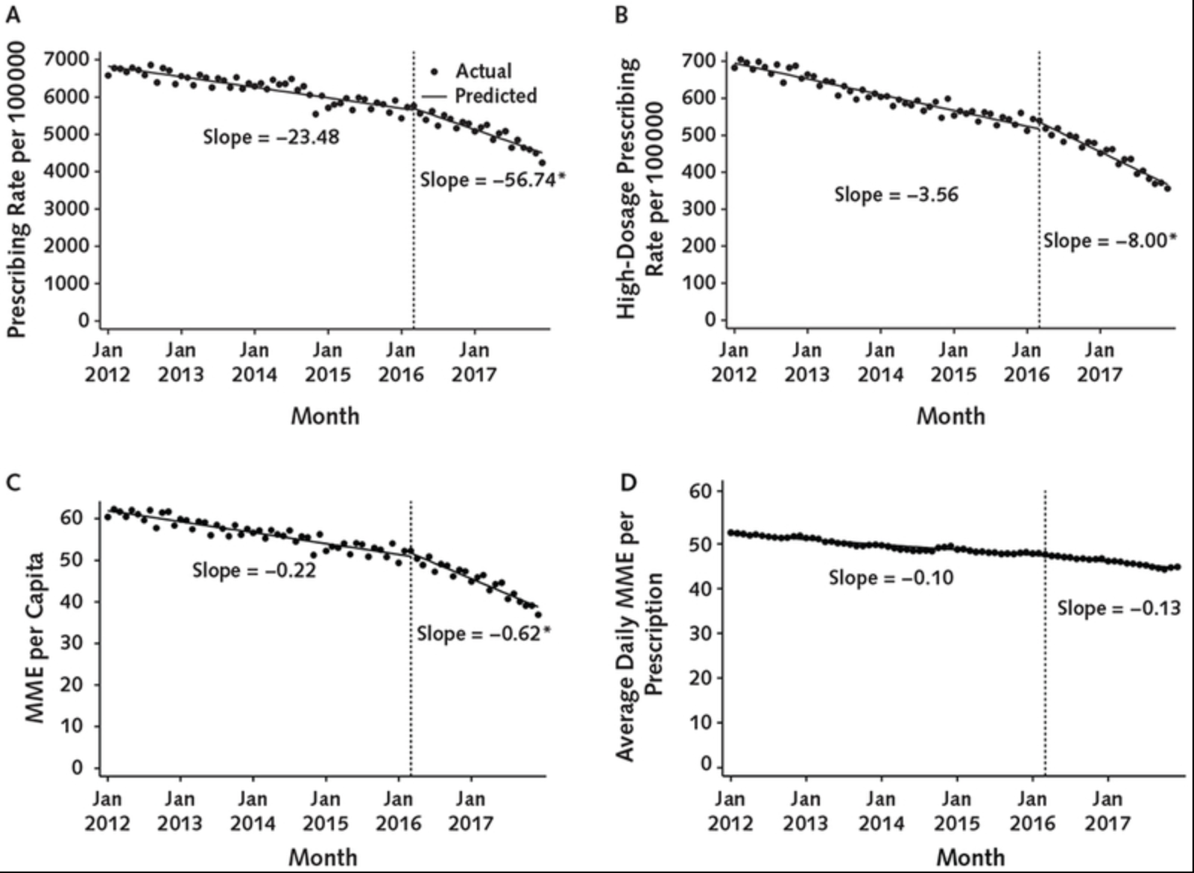
Rates of Prescribing
Bohnert, Aet al; Opioid prescribing in ;the US before and after the CDC’s 2016 opioid guidelines for prescribing opioids for chronic pain. Ann of Internal Medicine 2018; 169:367-75. PMD: 30167651
Opioid Use Disorder History and Epidemiology

Slide 16
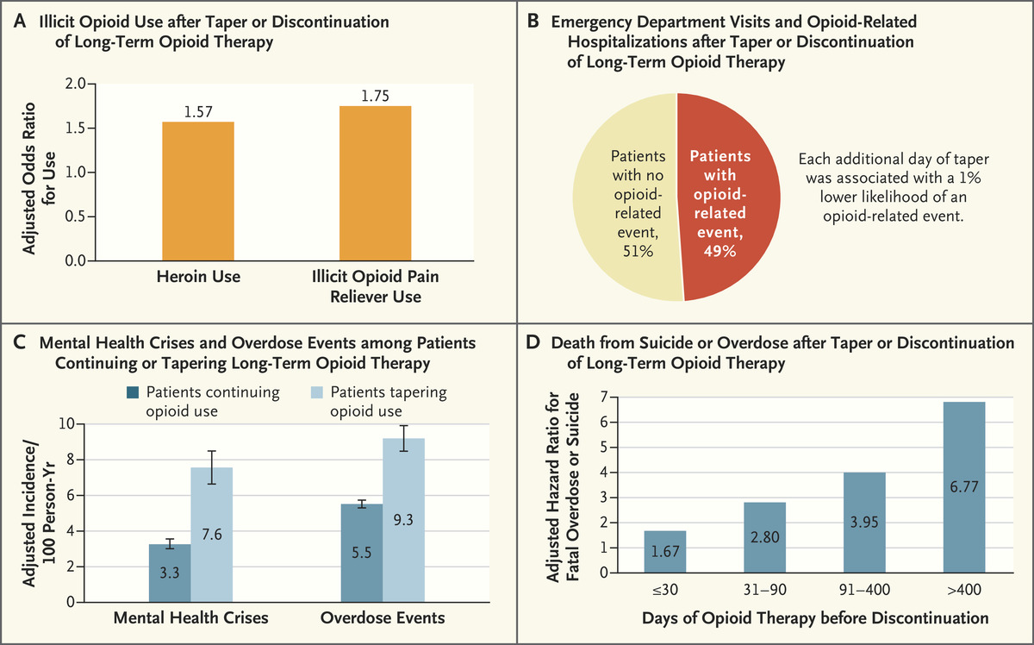
Risks Conferred
by Tapering or
Discontinuing
Long-Term
Opioid Therapy
PO Coffin, AM Barreveld. N Engl J Med 2022;386:611-613.
Opioid Use Disorder History and Epidemiology

Slide 17
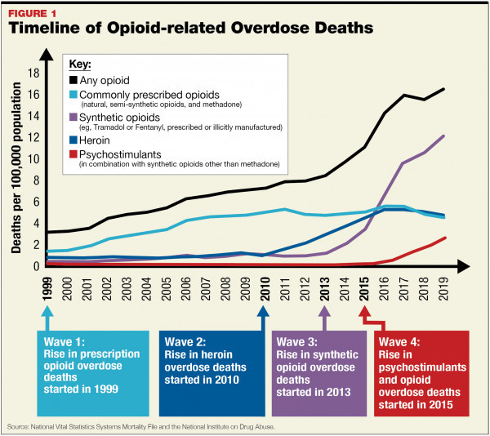
Rise of Overdose
Deaths
Opioid Use Disorder History and Epidemiology

Slide 18
The 4th Wave
”Legacy Patients” who have been prescribed COT – can’t get providers to continue medications
We are now dealing with synthetic opioids that are 100-1000 x the potency of morphine
High potency synthetic opioids are now evolving, less detectable and mixed with other substances which are increasing the OD potential – i.e., methamphetamine, xylazine, benzodiazepines
Opioid Use Disorder History and Epidemiology

Slide 19
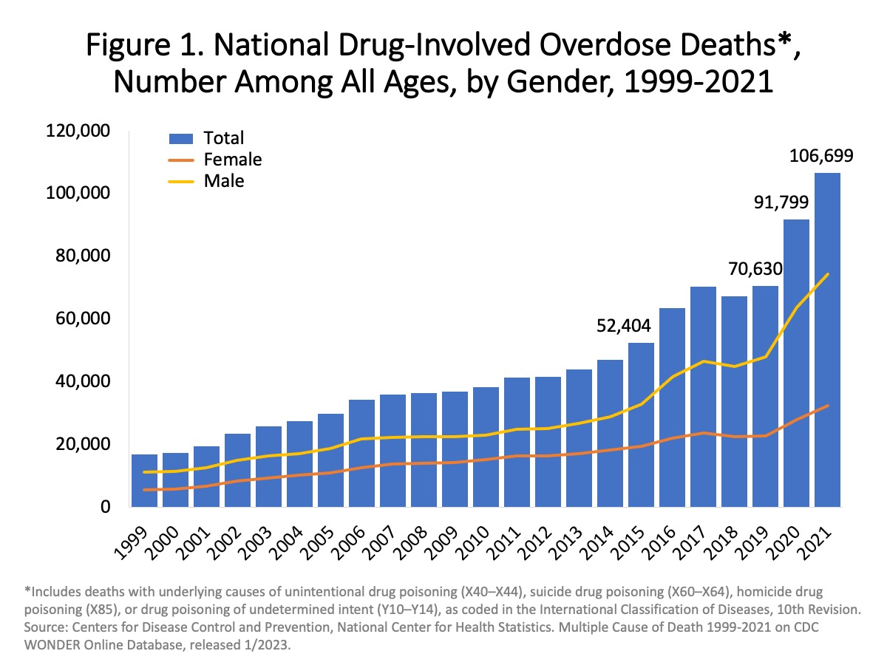
The height of the overdose deaths – 2021-2023
There were 111,355 overdose deaths in the 12-month period ending April 2023, compared with 110,394 deaths in the 12-month period ending March 2022.
Opioid Use Disorder History and Epidemiology

Slide 20
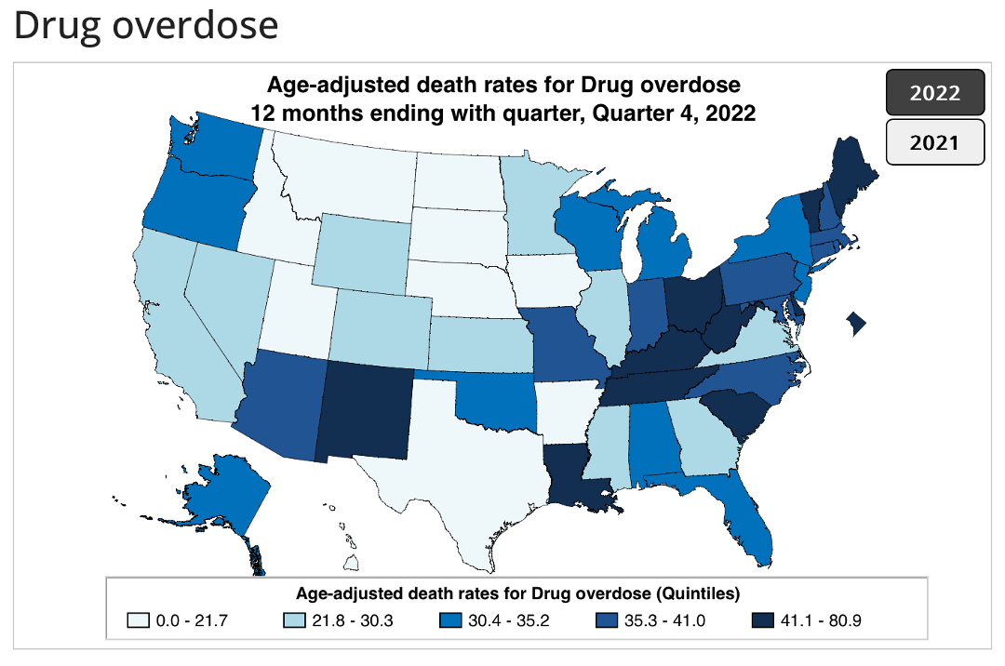
New Mexico Ranking as of 2022 – 5th highest
Ahmad FB, Cisewski JA. Quarterly provisional estimates for selected indicators of mortality, 2022-Quarter 1, 2023. National Center for Health Statistics. National Vital St
Opioid Use Disorder History and Epidemiology

Slide 21
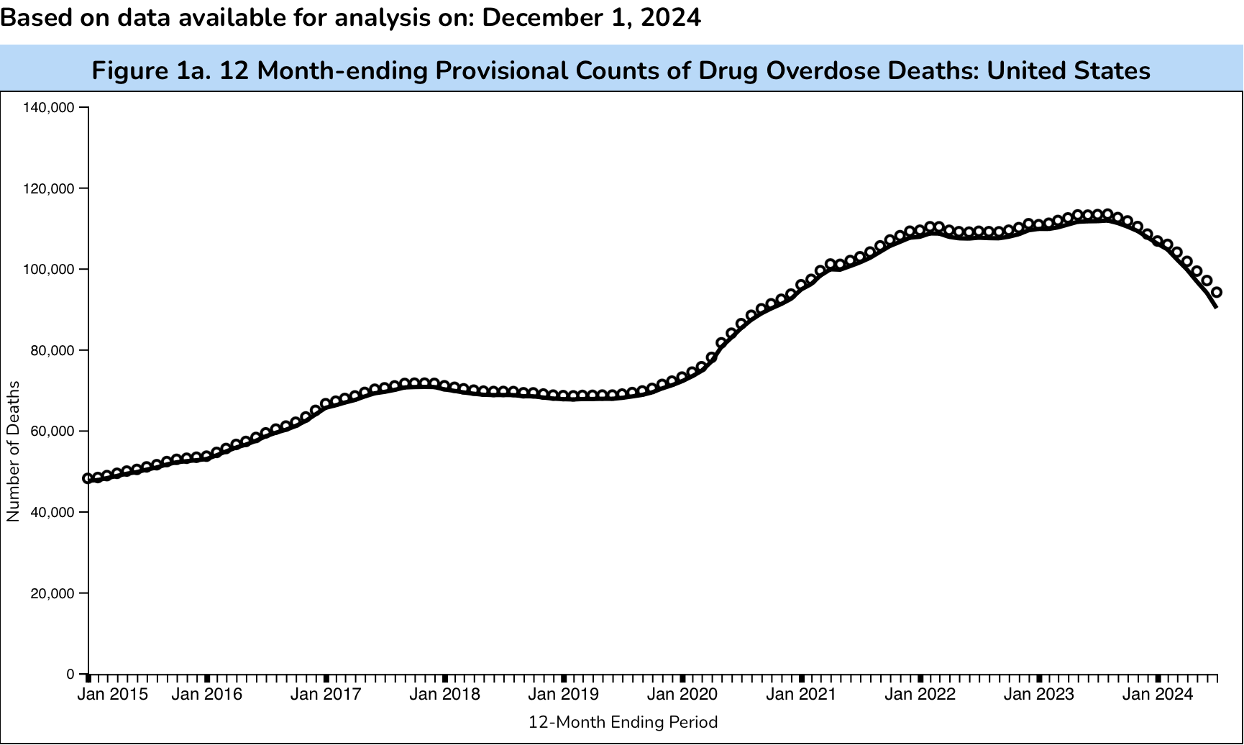
Recent Good News Over the Past Year
Ahmad FB, Cisewski JA, Rossen LM, Sutton P. Provisional drug overdose death counts. National Center for Health Statistics. 2024
Opioid Use Disorder History and Epidemiology

Slide 22
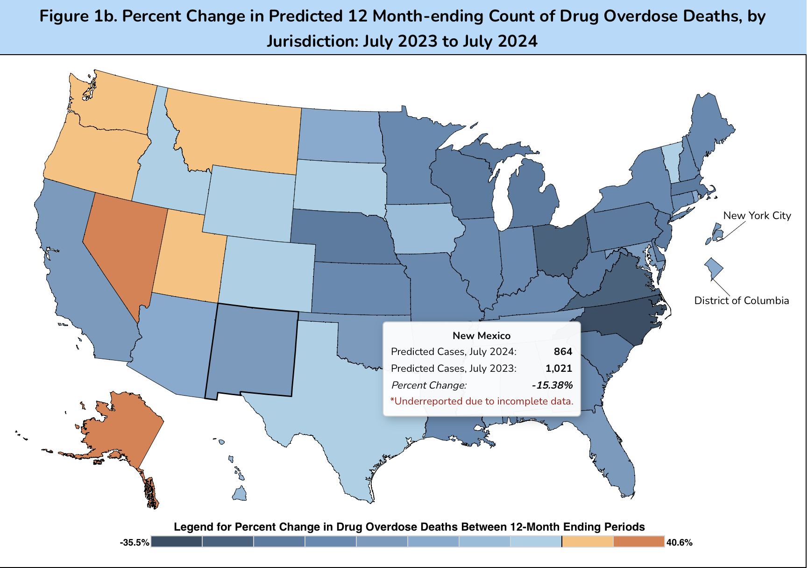
Good News for New Mexico Too!
Ahmad FB, Cisewski JA, Rossen LM, Sutton P. Provisional drug overdose death counts. National Center for Health Statistics. 2024
Opioid Use Disorder History and Epidemiology

Slide 23
New Mexico Health Department Announces Decline in Overdose Deaths – Jan 7, 2025
Counties with high OD rates > 20 deaths:
Bernalillo
Santa Fe
Rio Arriba
San Miguel
Overdose rates declined 8 % since 2021.
Peak deaths at 1,029 in 2021 and fell to 948 in 2023.
Fentanyl involved in 65% of deaths. Methamphetamine in 51%.
84% among 25-64 years. 26% in 35-44 age group.
Opioid Use Disorder History and Epidemiology

Slide 24
What is causing the decline in deaths?
Expert’s speculation:
  Availability/accessibility of Naloxone for reversal.
  More access and less restrictions on treatment.
  Blip vs sustained downward trend.
  Changes in drug supply – additives that change portion of fentanyl.
  More effective interdiction of fentanyl at the border.
  Tolerance by fentanyl users has increased.
No definitive answers at this time.
Overdose death rates, despite decline are still higher than MVA deaths.
While addiction experts are ecstatic about the decline in deaths, the reasons are still unclear
https://www.nytimes.com/2024/09/21/us/politics/drug-overdose-deaths-decrease/html.
Opioid Use Disorder History and Epidemiology

Slide 25
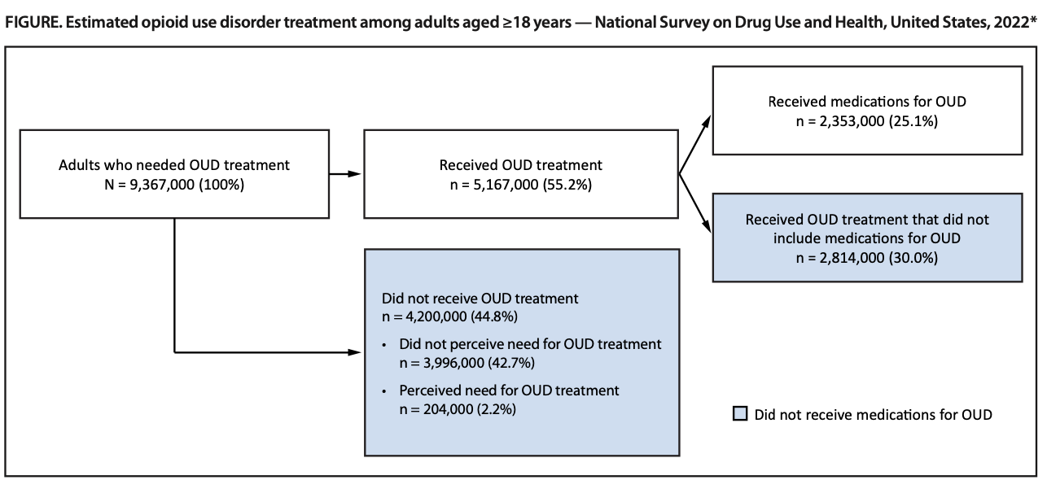
There are still challenges
Dowell, D et al, “Treatment for OUD: Population Estimates – US 2022” MMWR, Vol 73/No 25, 07/27/24
Opioid Use Disorder History and Epidemiology

Slide 26
There are still challenges
Lower % of Black and Hispanic adults receive OUD treatment compared to White adults.
Lower % of women and younger and older OUD patients received medications.
43% adults meeting OUD treatment criteria didn’t believe they needed treatment.
Bias among clinicians equating MOUD with illegal substance use.
Methadone unavailable in many areas – particularly rural communities.
Dowell, D et al, “Treatment for OUD: Population Estimates – US 2022” MMWR, Vol 73/No 25, 07/27/24
Opioid Use Disorder History and Epidemiology

Slide 27
There are still challenges
Many residential and outpatient programs do not accept patients on MOUD.
PCP despite lifting waiver requirements uncomfortable using buprenorphine.
Many payors have prior authorization restrictions on many buprenorphine formulations.
Large portions of pharmacies do not stock buprenorphine.
Dowell, D et al, “Treatment for OUD: Population Estimates – US 2022” MMWR, Vol 73/No 25, 07/27/24
Opioid Use Disorder History and Epidemiology

Slide 28
Footnote References
Institute of Medicine(IOM), Relieving Pain in America: A Blueprint for Transforming Prevention, Care, Education and Research. The National Academies Press 2011 Washington DC.
Zelaya, CE, Dahlmer JM et al, Chronic Pain and high-impact chronic pain among US adults, 2019. NCHS Data Brief 2020l 390:1-8. PMID 33151145
IMS’s Source Prescription Audit (SPA) & Vector One®: National (VONA)
Chabal, C., M. K. Erjavec, et al. (1997). "Prescription opiate abuse in chronic pain patients: clinical criteria, incidence, and predictors." Clin J Pain 13(2): 150-155.
Caudill-Slosberg MA, Schwartz LM, Woloshin S. Office visits and analgesic prescriptions for musculoskeletal pain in US: 1980 vs. 2000. Pain 2004;109:514-9.
The SUD-QUERI Executive Committee, "Improving Access to Opioid Agonist Therapy,", QUERI Update, VA Office of Research and Development and HSR&D Quality Enhancement Research Initiative, June 2012.
Bohnert M, Valenstein M, Bair M, Ganoczy D, McCarthy J, Ilgen M, Blow F. Association between opioid prescribing patterns and opioid overdose-related deaths. JAMA 2011;305(13):1315-1321.
Opioid Use Disorder History and Epidemiology

