Slide 1

Opioid Remediation Collaborative (ORC)
of New Mexico
orcnm.com
Rationale and Methodology for Drug Testing

Slide 2

Disclosures
Consultant Medical Director:
Turning Point Recovery Center, Albuquerque
Vista Taos, Taos
LifeHouse, Carlsbad
Consultant Clinical Director:
Southwest Laboratories, Albuquerque
Addiction Medicine Team Consultant:
Opioid Remediation Collaborative of New Mexico (ORCNM.com)
Rationale and Methodology for Drug Testing

Slide 3
Reasons for testing:
Medical Emergency
  Altered mental status not otherwise explained
Impairment
  Acute change in consciousness or behavior
Employment
  Pre-employment
  “for cause”
“Safety sensitive” work
  Pilots, train engineers, truck drivers, healthcare personnel
Forensic
  DUI
  Court-ordered requirements
Rationale and Methodology for Drug Testing

Slide 4
Reasons for testing:
Special populations in recovery:
  Judges and Lawyers
    JLAP
  Pilots
    FAA, “Birds of a Feather”
  Physicians and Advanced Practice Clinicians
    NMHPWP
  Nurses
    BON Diversion Program
Clinical care
  Patient compliance
  Diversion
Drug & Alcohol Treatment
  Establish “Drugs of Choice”
  Monitor abstinence
  Detect relapse
Rationale and Methodology for Drug Testing

Slide 5
Choices of Testing and Testing Methodology
Breathalyzer
  POC, Alcohol only
  Non-invasive
Oral Fluid Testing
  POC, broad spectrum
  Non-invasive
  Direct to confirmation by LCMS
Urine
  Invasive, requires witness
  POC screen or confirmatory
  Both alcohol and drugs
    ETG
Blood
  Invasive
  Both alcohol and drugs
    PEth
Hair/Nails
  Invasive
  Both alcohol and drugs
Rationale and Methodology for Drug Testing

Slide 6
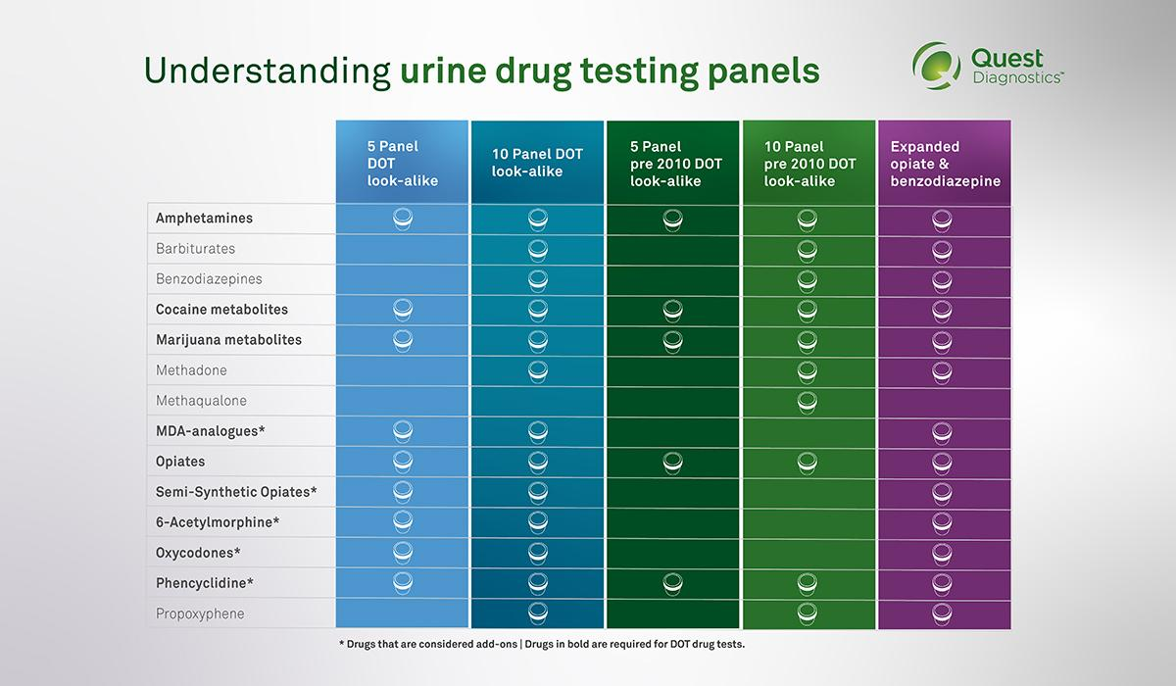
Know what you are asking for?
Rationale and Methodology for Drug Testing

Slide 7
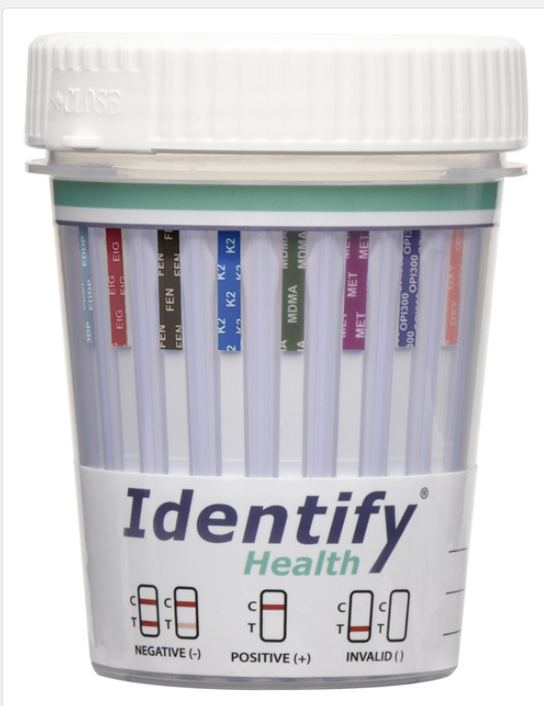
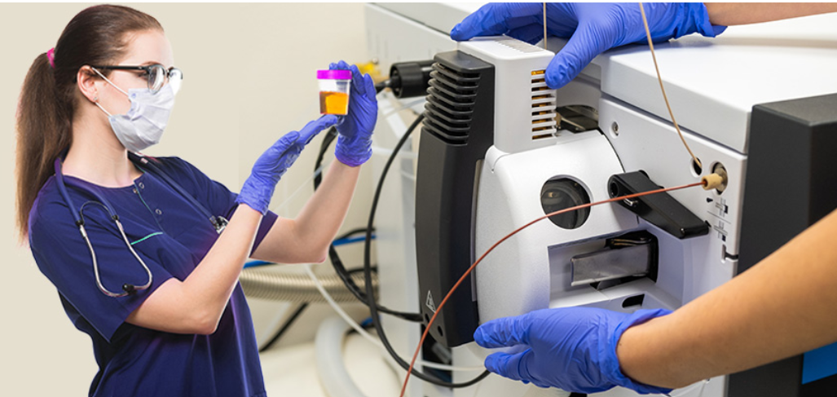
Steps in testing:
Screening (qualitative) tests
Point-of-care cup
Chemistry analyzer
Semiquantitative HPLC Screen
Confirmatory (quantitative) tests
Urine, oral fluid samples
Liquid chromatography mass spectrometry (LCMS)
Rationale and Methodology for Drug Testing

Slide 8
General guidelines for testing (and compensation)
Quantitative testing for a particular drug is considered medically necessary only if one of the following criteria is met:
Qualitative testing was positive for a Rx drug that is not prescribed
Qualitative testing was negative for a Rx drug that is prescribed
Qualitative testing was positive for an illicit drug
Qualitative testing for a suspected substance is not commercially available
For more detailed information on guidelines from BCBSNM: https://medicalpolicy.bcbsnm.com/activePolicyPage?path=medicine/MED207.154_2024-06-15&corpEntCode=NM&corpEntCd=NM
Rationale and Methodology for Drug Testing

Slide 9
Know your “windows of detection”
Immediate, current use (now!):
Oral fluid, Breathalyzer, Blood
Recent use (6-96 hours), requiring metabolization to detectable levels of metabolites:
Urine, ETG, Blood (Drugs and PEth)
PEth is 3-12 days
Past use (90+ days), using accumulated metabolites:
Hair/nails
Rationale and Methodology for Drug Testing

Slide 10
Useful online references:
Drug testing guidelines from BCBSNM:
  https://medicalpolicy.bcbsnm.com/activePolicyPage?path=medicine/MED207.154_2024-06-15&corpEntCode=NM&corpEntCd=NM
Frequency of drug testing from CMS:
  https://www.cgsmedicare.com/partb/mr/pdf/urinary_drug_testing_factsheet.pdf
Urine drug testing from the National Library of Medicine:
  https://www.ncbi.nlm.nih.gov/books/NBK574915/table/p5.t2/
Oral fluid drug testing from the AAA Foundation:
  https://aaafoundation.org/wp-content/uploads/2019/07/19-0297_AAAFTS_Oral-Fluid-Research-Brief_r2.pdf
Peth alcohol testing from the NIH:
  https://pubmed.ncbi.nlm.nih.gov/27596747/
ETG alcohol testing from the NIH:
  https://pmc.ncbi.nlm.nih.gov/articles/PMC4663163/
Hair drug testing from LabCorp:
  https://www.labcorp.com/frequently-asked-questions/drug-testing/workplace-drug-testing/hair-drugs-of-abuse-testing
Rationale and Methodology for Drug Testing

